Slide 1
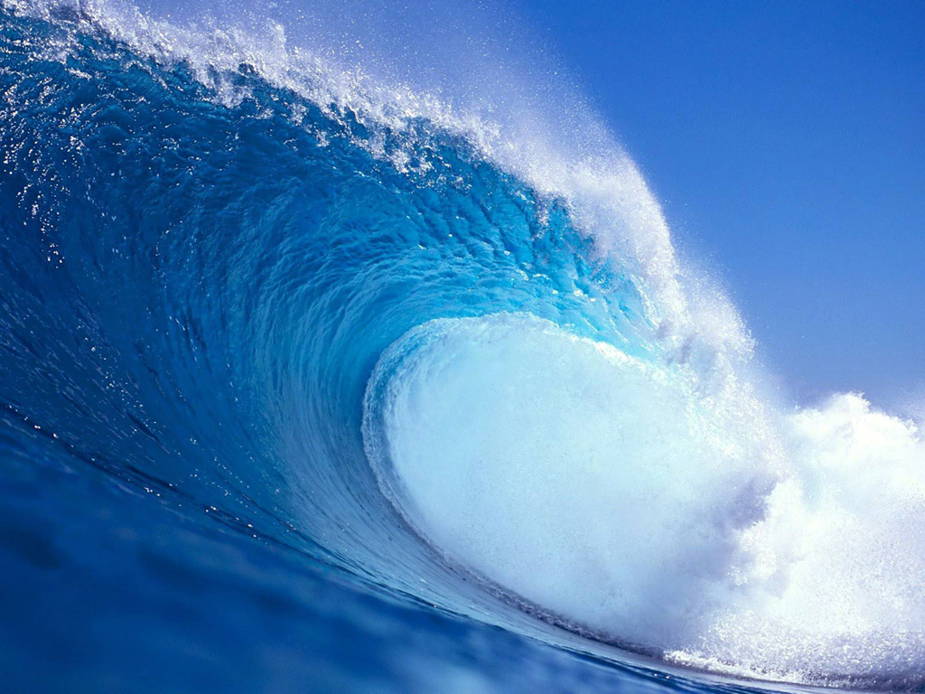
Waves!

Slide 2
What are Waves?
Wave motion is created by the transfer of energy through a material (in our case, water). Each molecule of water receives the energy and “passes” it to the next molecule.
In theory, the water particles do not move as the energy passes.
The particles of water either move back and forth or in an orbital pattern.

Slide 3
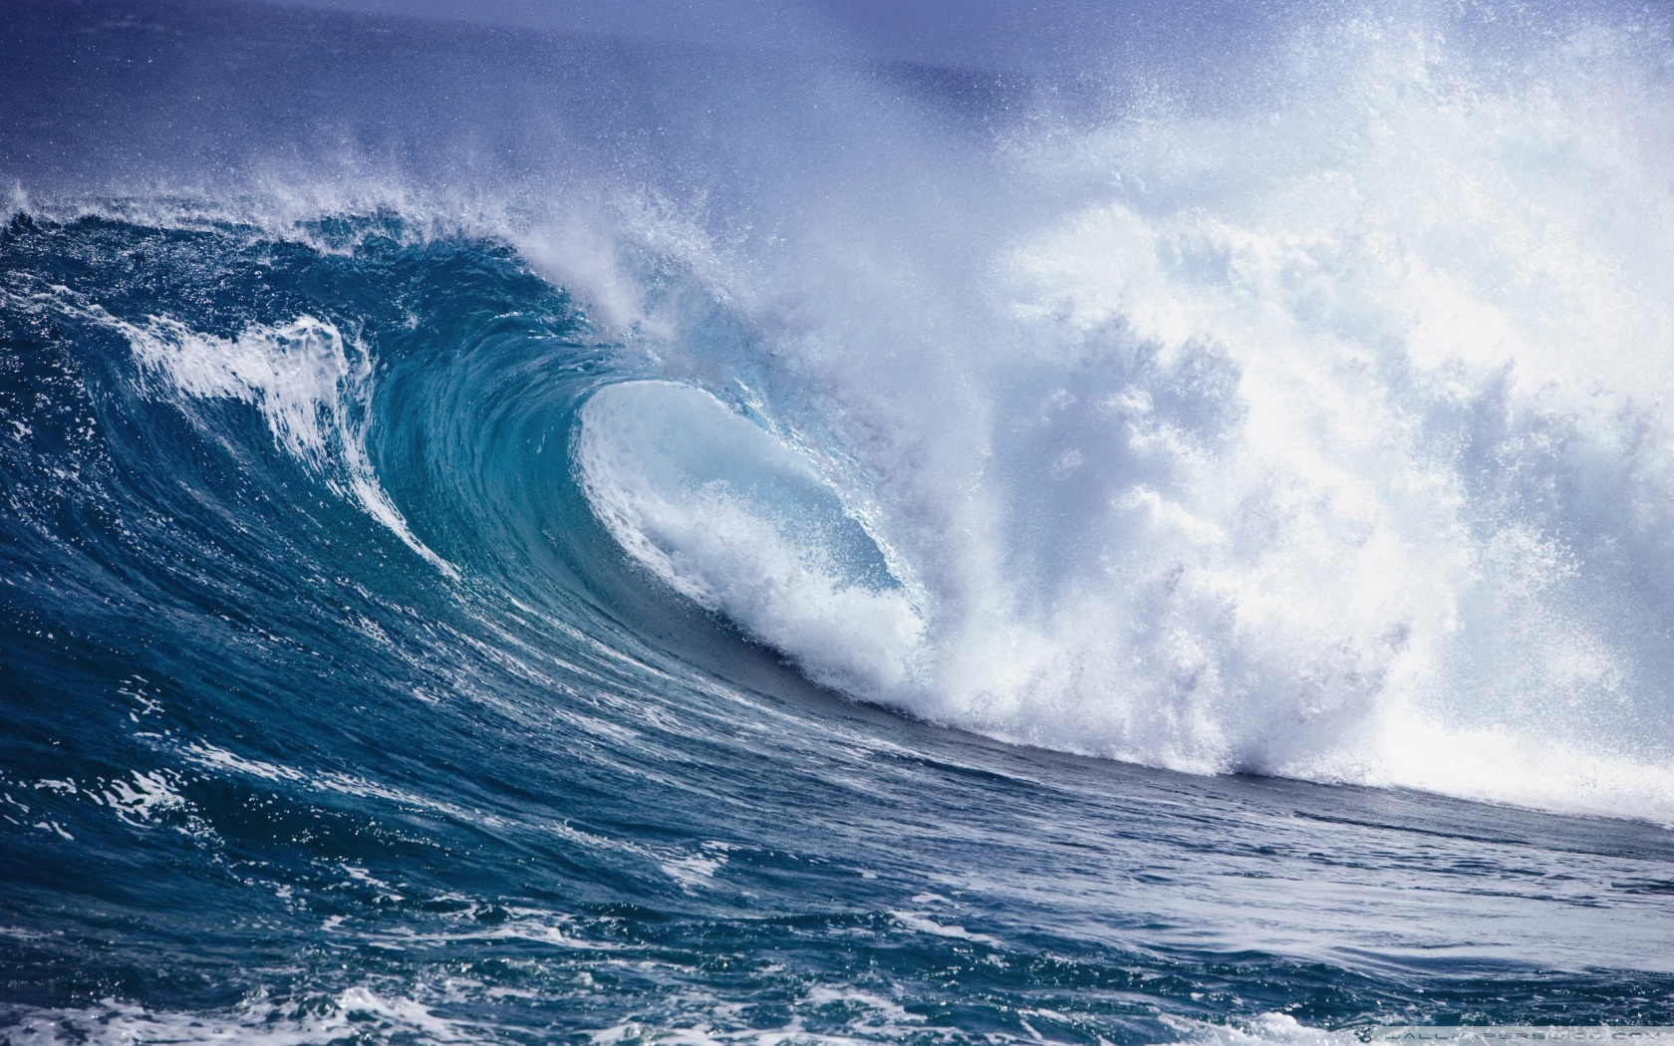
What are Waves?
Imagine the fans at a baseball game doing the wave. The wave is “passed” around the stadium, but the fans don’t actually change their seats.
All waves need to have a source for the energy that they possess.
Notes:
https://www.youtube.com/watch?v=uc-KjZjMw0I

Slide 5
Types of Waves
Progressive waves:
These look like they’re going somewhere
Wind-generated waves (caused by weather patterns)
Sudden event waves (caused by nature – earthquake, volcano, etc)

Slide 6
Types of Waves
Standing waves:
These are waves that become trapped in a bay or basin
The entire mass of water sloshes back and forth until the energy is used up.
Ex: water in a container or waves between a boat and the wharf.

Slide 7
General Wave Characteristics

Slide 8
Definitions:
Wave height: the distance (in meters) from a trough to a crest
Wavelength: the distance (in meters) between two crests
Crest: the highest point on a wave
Trough: the lowest point on a wave
Amplitude: the distance (height) from the still water line to the crest
Still water line: the height of the water with no energy present (midway between the crest and the trough

Slide 9
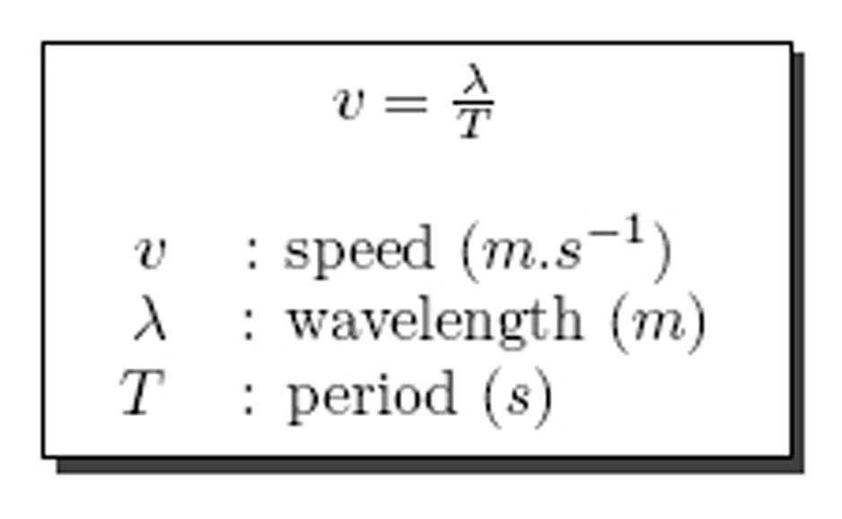
Definitions:
Frequency: the amount of wave lengths passing by a certain point in one second. Expressed in “wavelengths/second” or “Hertz”
Period: the amount of time for one wavelength (2 successive crests) to pass a point. Usually measured in seconds
Wave Speed: measure how quickly a wave moves through the water.

Slide 10
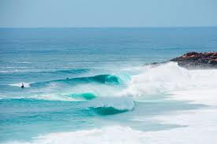
What is Swell?
Swell is created as waves “sort themselves out” after a storm
Crests are long and smooth
Swell waves are “rolling” waves. They usually move in groups outward from a storm’s center
Notes:
https://www.youtube.com/watch?v=uYI1QgxTMTA

Slide 11
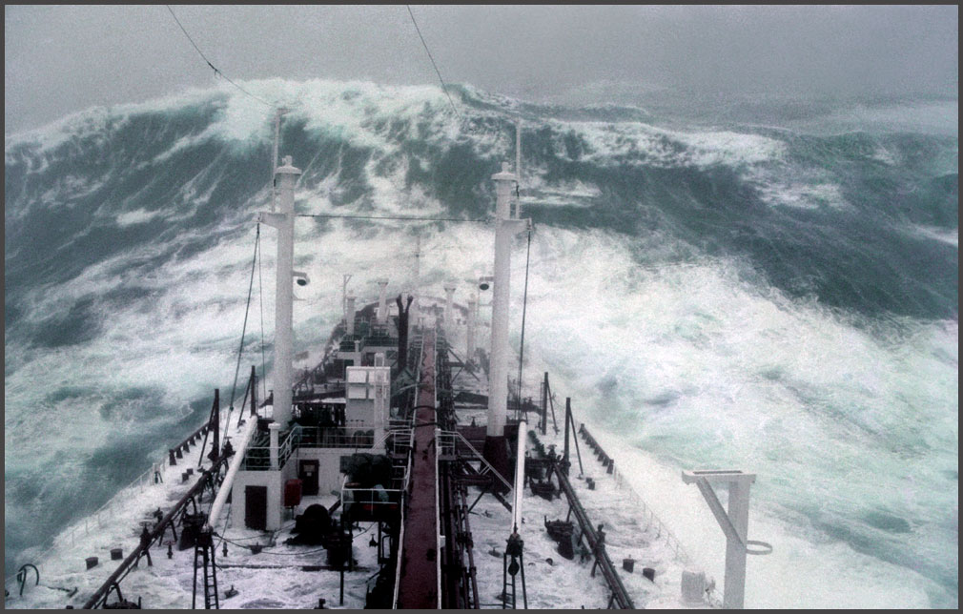
Rogue Waves
A common saying is that “every 7th wave is the largest to hit the shore”
A rogue wave is a very large wave which seems to appear out of nowhere. It is thought to be the addition of many small waves
Notes:
https://www.youtube.com/watch?v=5kCrnmBViwo
https://www.youtube.com/watch?v=Roayx-79cAs

Slide 12
What Creates a Large Wave?
1. High wind Speed
2. Winds that only blow in one direction
3. Winds moving over a large area (large fetch)

Slide 13
How Do Waves Break?
Waves begin to break (lose their shape) when they “feel” the bottom near the shore. (This is when the depth = half the wavelength)
What happens?
1. Wave speed decreases – although the wave moves faster at the crest, the wave topples over – like a runner that has been tripped.
2. Wave length decreases
3. Wave height increases – because the wave is getting taller (stretching), the crest becomes unstable and the wave breaks (falls over)

Slide 14
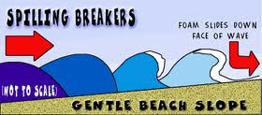
Types of Breaking Waves
1. Spilling Waves
Most common type
Occur on flat beach slope
Roll in evenly over long distances
Turbulent water and bubbles spill down over the front of the wave

Slide 15
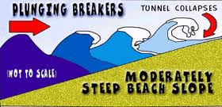
Types of Breaking Waves
2. Plunging Waves
Occur on steep beach slope
Crest of wave curls over a large air pocket, forms tunnel
Surfers love this type!

Slide 16
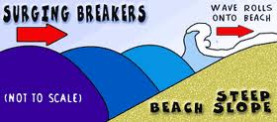
Types of Breaking Waves
Surging Breakers
Don’t actually “break”
Instead, it rolls onto the steep beach.
These kinds of breakers are known for their destructive nature.
Notes:
https://www.youtube.com/watch?v=YPgr-alTnQs

Slide 17
