Slide 1
Major Types of Coastal Zones

Slide 2
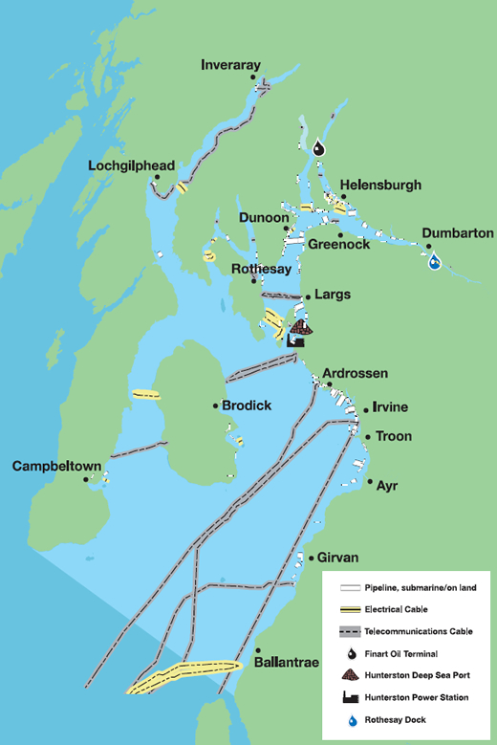
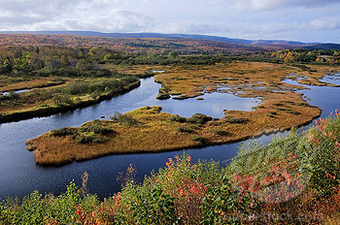
Estuaries
Partly enclosed coastal body of water with one or more rivers/streams flowing into it and a free connection to the open sea. (fresh water mixes with ocean)

Slide 3
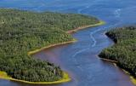
Estuaries Continued…
Economically significant as seaports, centers of ocean commerce and commercial fisheries
Challenges faced by the organisms in the area:
Salt levels fluctuate
Finding a living condition that stays constant
Pugwash

Slide 4
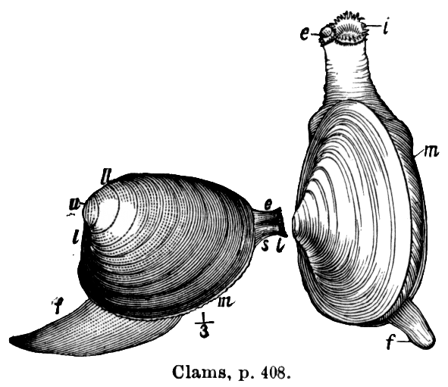
Estuaries Continued…
Wildlife
Phytoplankton, bacteria, fungi, eelgrass
Worms, clams, crabs, lobster, birds
Human Activities
Fishing, aquaculture, recreational fishing, pollution

Slide 5
Rocky Shores
Dominated by bedrock, boulders, and cobbles

Slide 6
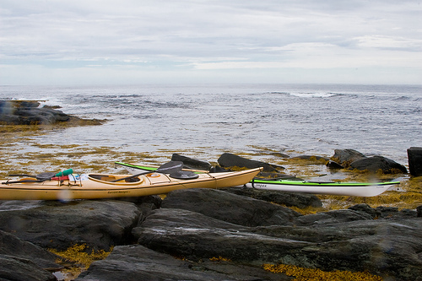
Rocky Shores Continued…
Challenges faced by the organisms in the area:
Wind, ice, temperature, currents, tides, salt is always changing

Slide 7
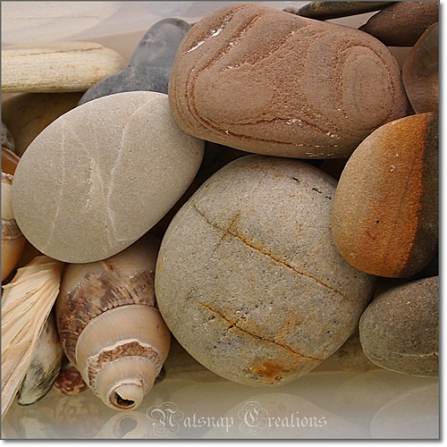
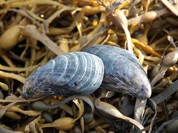
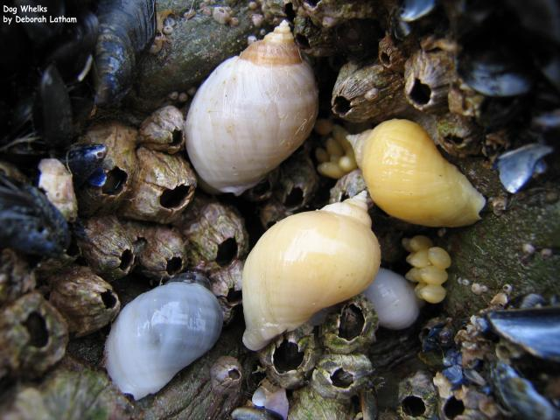
Rocky Shores Continued…
Wildlife
Seaweed, periwinkles, dog whelks, mussels, oysters, clams, limpets, sea slugs, barnacles, crabs, starfish
Human Activities
Collection of stones, rocks, glass
Difficult to access

Slide 8
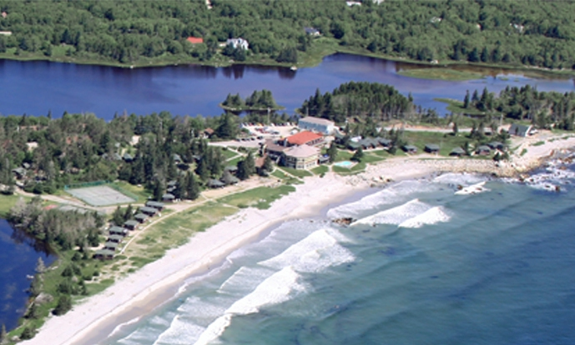
Sandy Beaches
Sandy – fine, coarse sediment
Can have gravel and rocks
White Point Beach

Slide 9
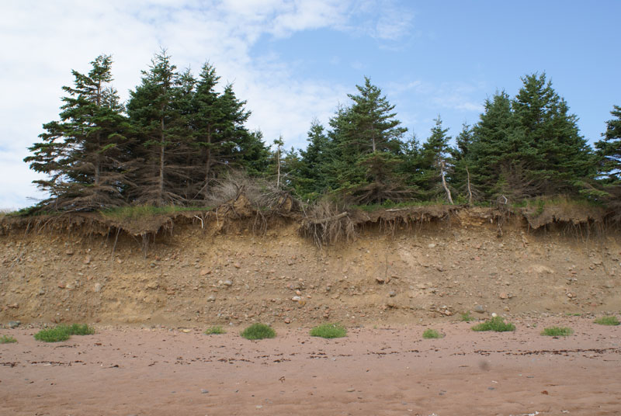
Sandy Beaches Continued…
Challenges faced by organisms in the area:
Wind and waves
Hard for plants/producers to establish
Erosion
Lack of shelter

Slide 10
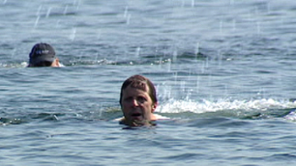
Sandy Beaches Continued…
Wildlife
Salt tolerant plants
Algae, beach grass
Animals: molluscs (snails, slugs) on shore
Crustaceans (crabs, barnacles), jellyfish, sand dollars in shallow waters
Marine birds
Human Activities
Tourism
Swimming
recreation

Slide 11
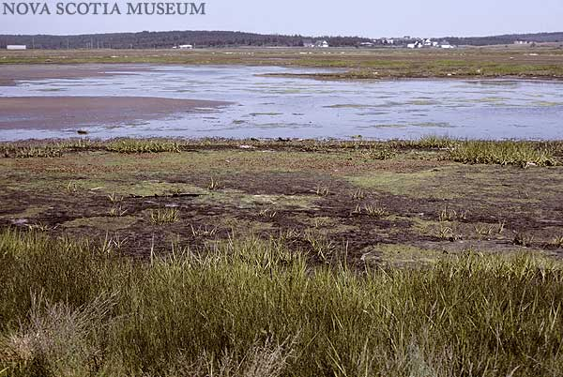
Salt Marshes
Smelly, grassy, mud
Found near estuaries and beaches
Can extend to mudflat

Slide 12
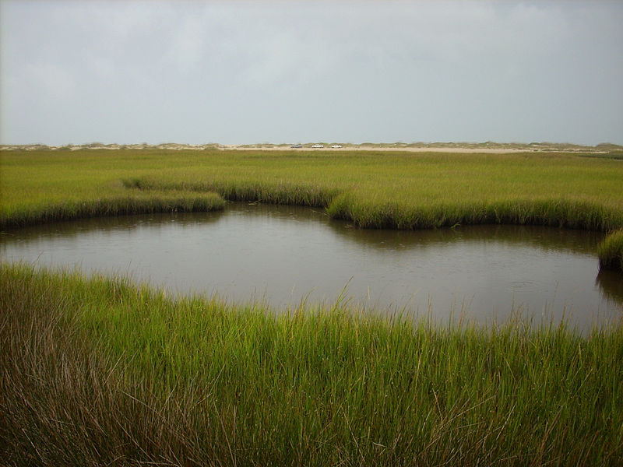
Salt Marshes Continued…
Challenges faced by the organisms in the area:
Salt conditions change
High salt content in summer
Less salt content after rain and runoff

Slide 13
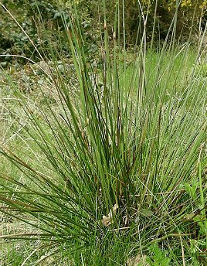
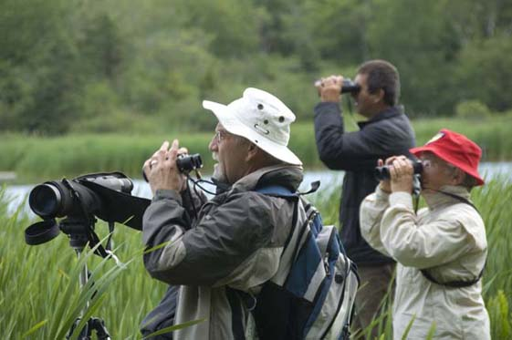
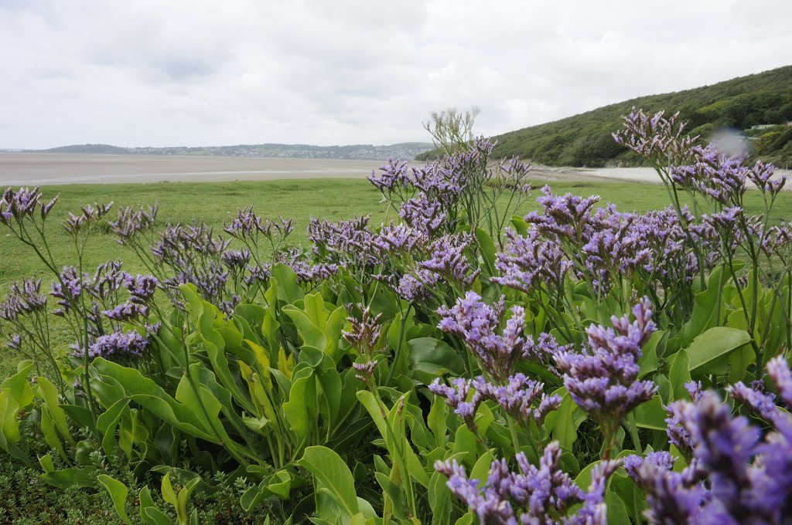
Salt Marshes Continued…
Wildlife
Rushes, sea lavender, sedge (grasses)
Mussels, dog whelks, crabs, worms, minnows, birds, fish
Human Activities
Bird watching

Slide 14
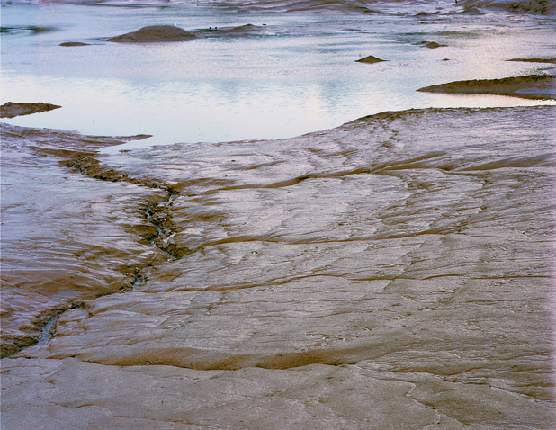
Mudflats
Silt, clay, fine sand, sloping shore
Starting point for salt marsh

Slide 15
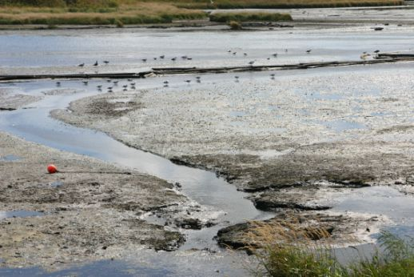
Mudflats Continued…
Challenges faced by the organisms in the area:
Currents change the shape
Salt levels vary

Slide 16
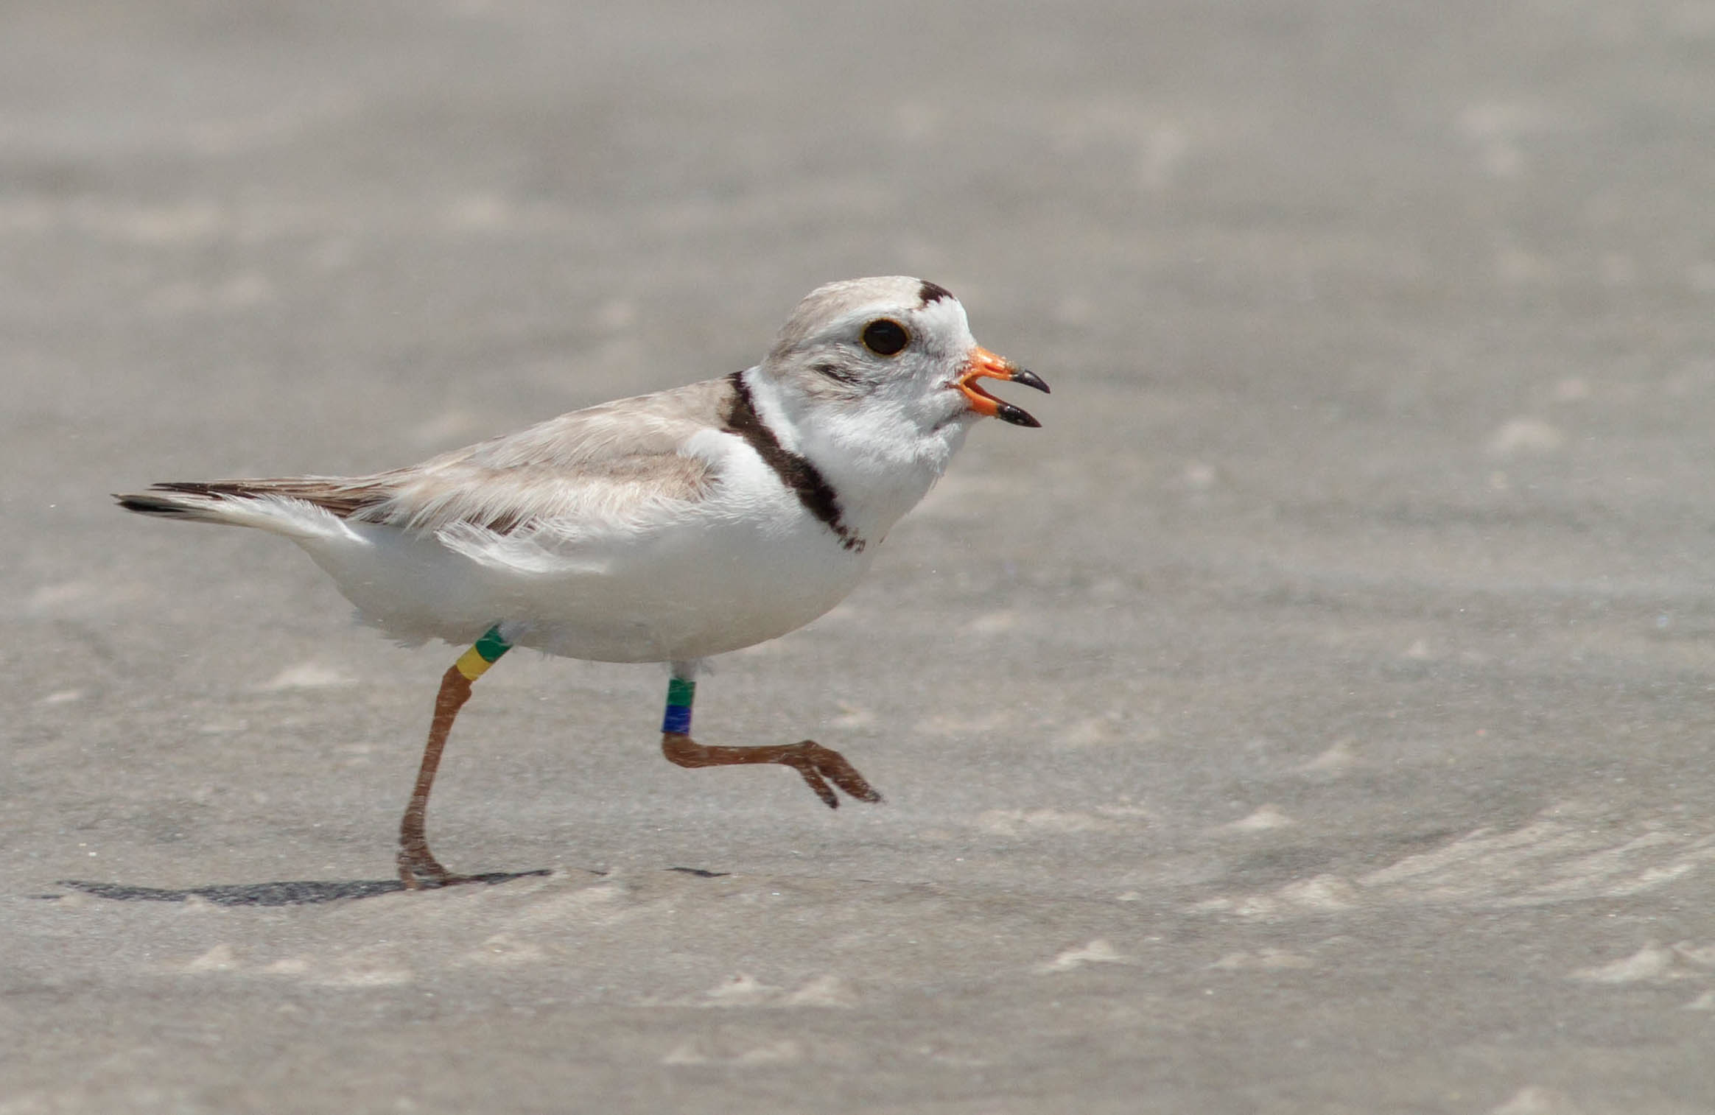
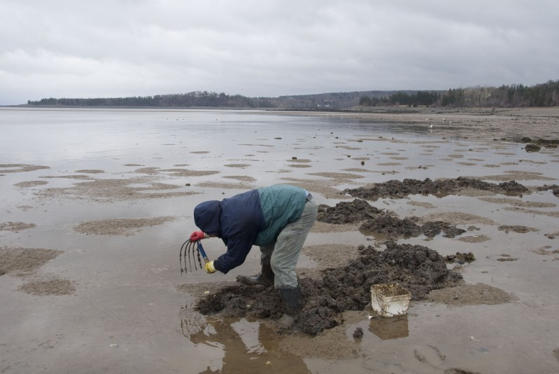
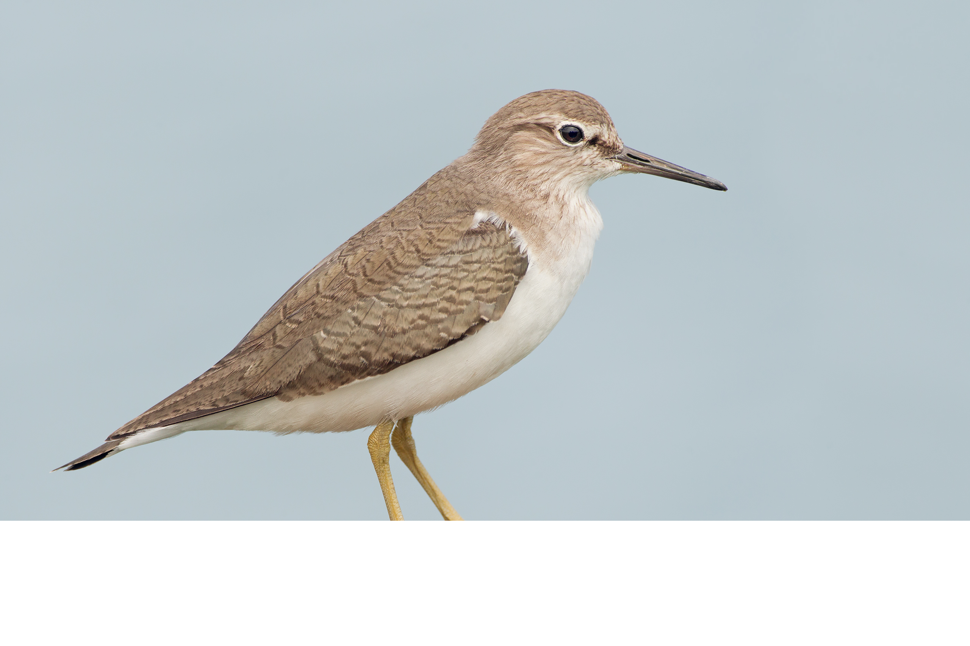
Mudflats Continued…
Wildlife
Few plants (some in upper region)
Diatoms, algae (microscopic to larger – kelp)
Bird: piping plover, sandpiper
Clams, mussels, burrowing worms
Human Activities
Clam digging
Bird watching

