Slide 1
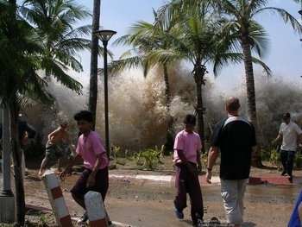
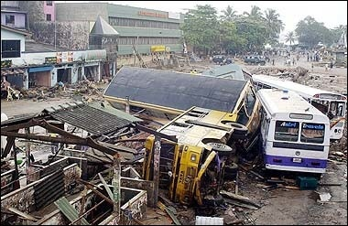
Tsunami

Slide 2
Intro Video…
https://www.youtube.com/watch?v=Wx9vPv-T51I#t=42

Slide 3
Tsunami
Japanese “Harbour Wave”
Very long wavelengths (distance between crests or troughs) often > 100 km
(high water levels for long periods of time)
High Speeds ( up to 800 km/hr)
Amplitude – Low (offshore) – 10 cm
High (Near coast) - > 10 m

Slide 4
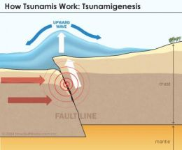
Causes of Tsunami
Undersea Earthquakes (most common)
Undersea Landslides
Undersea Volcanic Eruption
Large Meteorite Impact

Slide 5
Wave Amplification (Coast)
Shoaling
Wave slows as water depths decrease
Water behind will build up
Focusing
Bending of waves due to uneven bathymetry
Waves combine with one another
Resonance
Waves reflect off of shore…meet oncoming waves to create a standing wave.

Slide 6
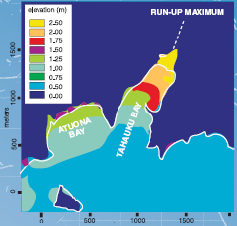
What can be done?
Monitor Worlds oceans
Research historical records
Use numerical models to understand past tsunami and to predict the risk of future tsunami events.

Slide 7
How people prepare for Tsunamis
Constructing breakwaters and tide embankments.
They use steel rods when constructing buildings to strengthen them.
They move entire towns to higher ground.
They stockpile drinks, food and goods.
They check evacuation routes
Humans can’t prevent tsunamis from happening but these things are helpful to protect the people living in the area that it occurs.

Slide 8
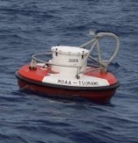
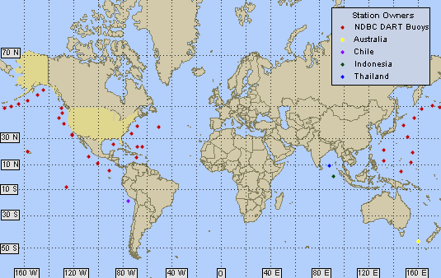
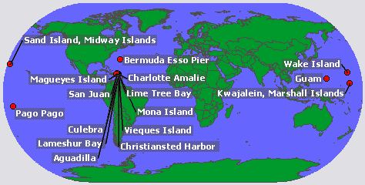
Warning systems
Station 46419 - 300 NM WNW of Seattle
Owned and maintained by National Data Buoy Center 2.6-m discus buoy DART II payload 48.478 N 129.359 W (48°28'41" N 129°21'32" W)
Deep ocean Assessment and Reporting of Tsunami
“DART”
Water level observation system

Slide 9
Tsunami Alerts
http://ptwc.weather.gov/
Pacific Tsunami Warning Centre (above)
http://wcatwc.arh.noaa.gov/
West Coast and Alaska Tsunami Warning Centre

Slide 10
Damage…
Deaths (drowning due to flooding)
Building destruction
Negative impact on fishing industries
Agricultural land destroyed

Slide 11
Papadapoulos-Imamura Scale (Tsunami)
Not felt
Scarcely felt
Weak
Largely observed
Strong
Slightly damaging
Damaging
Heavily damaging
Destructive
Very destructive
Devastating
Completely devastating

Slide 12
Newfoundland Tsunami - 1929
Magnitude 7.2 Earthquake
Triggered Underwater Landslide
…A Tsunami
28 deaths.
http://www.heritage.nf.ca/law/tsunami29.html

Slide 13
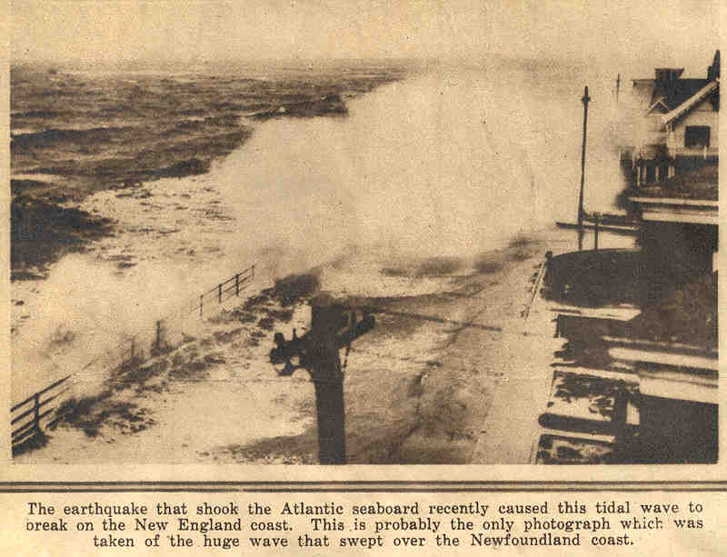
Toronto Star Weekly, Dec 6, 1929

Slide 14
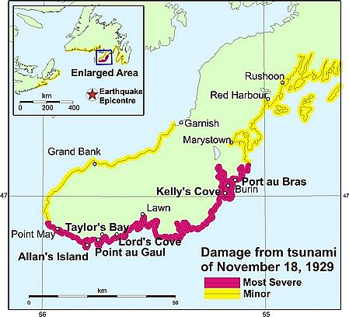

Slide 15
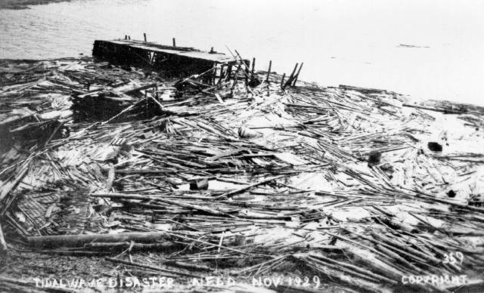
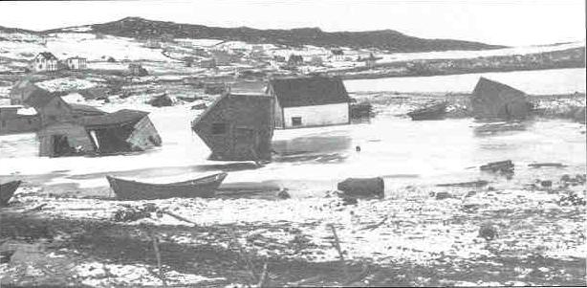
Photos of Burin Peninsula after tsunami, from the Provincial Archive, Government of Newfoundland and Labrador
http://earthquakescanada.nrcan.gc.ca/historic_eq/20th/1929/1929_e.php#Recent%20Research
Buildings in Lord's Cove tossed and smashed by the tsunami. Photograph by H.M. Mosdell, from the collection of W.M. Chisholm

Slide 16
Japan Tsunami 2011

Slide 17
Japan Tsunami 2011

Slide 18
Wave Height – Japan Tsunami

Slide 19
Incoming Japan Tsunami
https://www.youtube.com/watch?v=yiENf1f1tIA
https://www.youtube.com/watch?v=ceym2c18OQM&feature=related
https://www.youtube.com/watch?v=hTeQt3KmpNA&feature=related
http://www.bbc.com/news/world-asia-pacific-12725646

Slide 20
Japan Tsunami Clean-up
http://blogs.sacbee.com/photos/2011/09/japan-marks-6-months-since-ear.html

Slide 21
Stop Disasters – Tsunami Game
Reviews ways to help reduce the damage and the number of deaths resulting from a tsunami.

