Slide 1
Salinity

Slide 2
Salinity
“Salinity” is defined as the amount of dissolved solids in the water. The most common dissolved solid is sodium chloride, commonly known as table salt.
The salinity of the oceans averages 3.45% by weight. This is usually expressed in “parts per thousand”, making the average salinity of seawater 34.5 ppt.

Slide 3
What Affects Salinity?
The salinity changes constantly due to many natural factors. When the air is warm, the air can hold more moisture. Water evaporates leaving the same amount of salt dissolved in less water. This causes an increase in the concentration (the amount of dissolved salts per unit volume) of the seawater. The higher the salt concentration of the water, the more dense the water. For example, the salinity of the Red Sea is 41%. This abnormally high salinity is caused by high evaporation and little precipitation.

Slide 4
Brackish Water
Water with a salinity of 1.7% is called “brackish water
(more salt than freshwater, but less salt than seawater)
Ex: Estuaries

Slide 6
More Salt…
Salt has always been a very valuable commodity to mankind. Its antiseptic and preservative powers have long been known.
Salt keeps our body chemistry in balance.

Slide 7
Salt = Money?
Salt has always been used as a currency, and the word “salary” comes from the word “salt” (ex: to earn one’s salt”). Even today, many tropical tribal societies still use salt as currency.
If the ocean makes up 90% of all the water on the planet, how do we get enough fresh drinking water?

Slide 8
Desalinating Water
The technology to desalinate (remove salt) from seawater has been around for a while. The most common method of removing the salt is called “reverse osmosis”. Now, this process has become such commonplace that many large ocean-going cruise ships and entire towns can be supplied with fresh water using this technology.
Ever wonder why we put salt on the roads in the winter?

Slide 9
TED – Clean Water
https://www.youtube.com/watch?v=rXepkIWPhFQ

Slide 10
Salt on Winter Roads
The presence of salt alters the properties of pure water. Pure water has a boiling point of 100 degrees and a freezing point of 0 degrees. Salt affects both the boiling point and freezing point of water. Adding salt to water increases the boiling point and lowers the freezing point. Therefore, rather than freezing and forming ice at 0 degrees, salt lowers the freezing point, making ice form at about -5 degrees.
When ice forms in seawater, it is only the pure water that freezes. The salt stays behind, making the water beneath the ice more salty.

Slide 11
Salinity Changes
Salinity is below average where a large amount of fresh water enters the ocean. When ocean water evaporates, the water becomes more dense because the salt remains in the water.
Salinity is reduced in areas of heavy rainfall, such as the equator. It also occurs where glaciers enter the oceans and at the mouth of rivers.

Slide 13
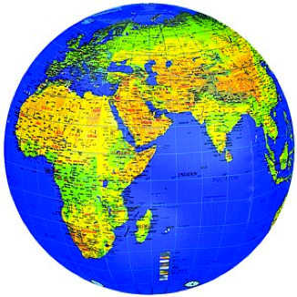
How much salt?!?!
If all the salts in the oceans of the world were dried up, they would yield enough salt to cover all of the Earth’s landmasses to a depth of 150 ft!!! That’s a lot of salt!

Slide 14
Dead Sea (High Salt Content)
https://www.youtube.com/watch?v=ZhL68D9BPiw

Slide 15
Where Does The Salt Come From?
Weathering of Rocks on Land
Volcanic Gases
Circulation at Deep Sea

Slide 16
Weathering of Rocks
Rain is slightly acidic and dissolves rocks and sediments in a slow process called weathering.
Calcium carbonate is particularly vulnerable to weathering.
Runoff and rivers carry the dissolved minerals from the land to the sea.

Slide 17
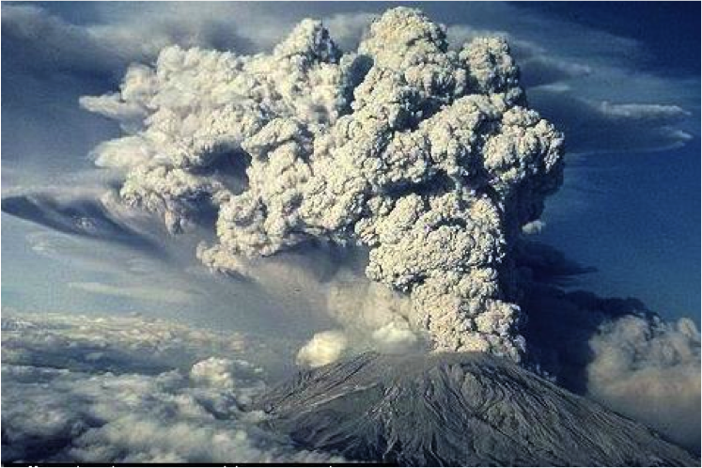
Volcanic Gases
Volcanoes spew gas rich in chlorine and sulfate (salts) from the Earth’s interior.

Slide 18
Summary – Sources of Salt
https://www.youtube.com/watch?v=EIDSMzXXzLM

Slide 19
Ocean Salt Content

Slide 20
Definitions
Halocline – The zone of the ocean in which salinity increases rapidly with depth
Pycnocline – The zone of the ocean in which density increases rapidly with depth. Temperature falls and salinity rises in this zone.
Thermocline – The zone of the ocean in which temperature decreases rapidly with depth.

Slide 21
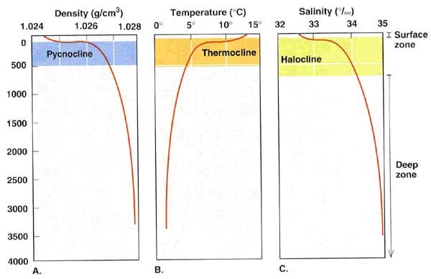

Slide 22
Halocline Video
https://www.youtube.com/watch?v=dHn80f3lAUs

Slide 23
Salt Webquest

