Slide 1
Structure & Motion Review

Slide 2
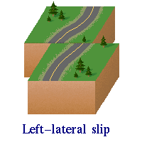
Earthquakes - 100
Left or Right Lateral Strike Slip fault?

Slide 3
Ocean Floor - 500

Slide 5
