Slide 1
NS Coastlines

Slide 2
NS Coastal Zones
Terrestrial Subsystem (in general)
Good relief (not too many areas are low lying)
Rocky or composed of glacial deposits
Freshwater input comes from numerous fairly small, short rivers that do not carry large sediment loads

Slide 3
NS Coastal Zones
Coast Subsystem (in general)
Mainly rock shore type with some sand beaches and relatively few marshes and estuaries (due to steep relief)

Slide 4
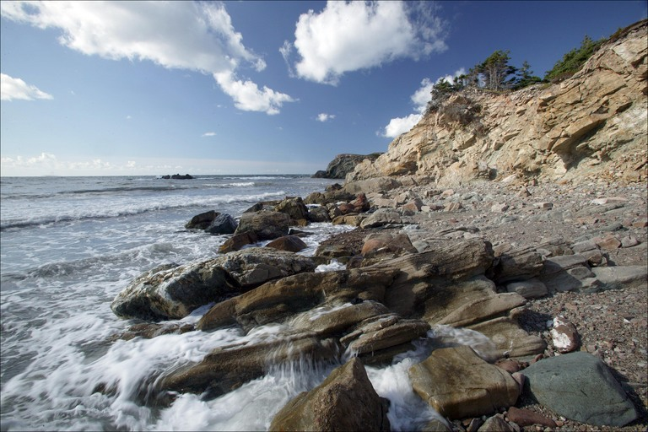
Rocky Shore – Cape Breton coast

Slide 5
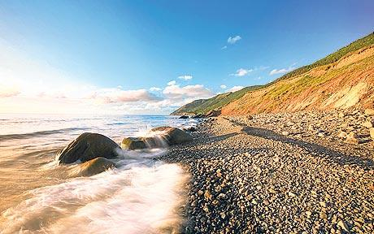
Rocky Shore – Trout Brook

Slide 6

Peggy’s Cove

Slide 7
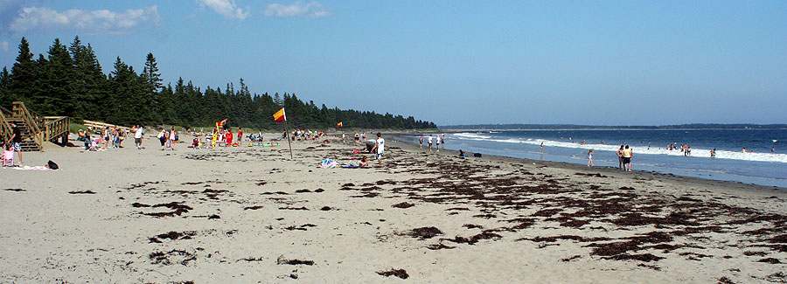
Risser’s Beach – South Shore

Slide 8
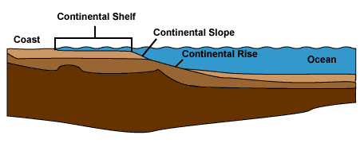
NS Coastal Zones
Marine Subsystem (in general)
Marine subsystems characterized by a wide trailing edge type of continental shelf.
Continental Shelf: is an underwater landmass which extends from a continent, resulting in an area of relatively shallow water known as a shelf sea.

Slide 9
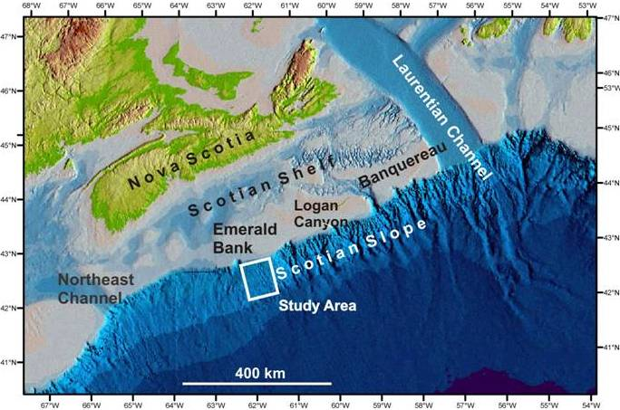
Notes:
Average Depth of 90m.

Slide 10
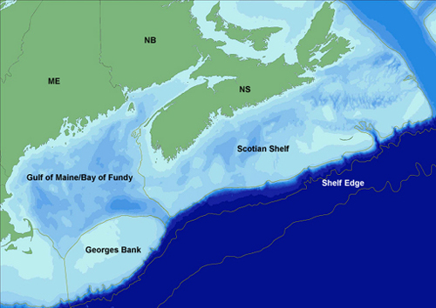

Slide 11
NS Coastal Zones
Marine Subsystem (in general)
- Marine subsystem dominated by a mixture of the cold waters of the Labrador Current and the outflow from the St. Lawrence River near shore and influenced by the Gulf Stream out near the edge of the Scotian Shelf.

Slide 12
NS Coastline Project

