Slide 1
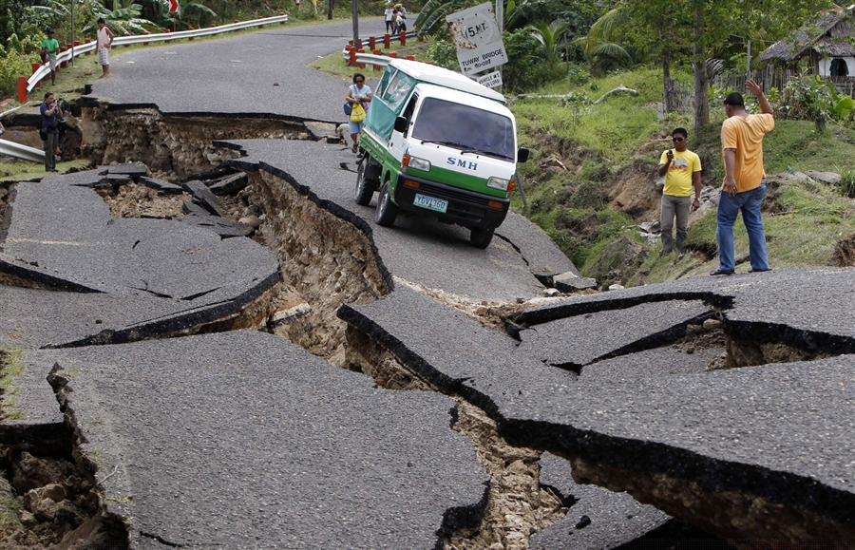
Plate Tectonics

Slide 2
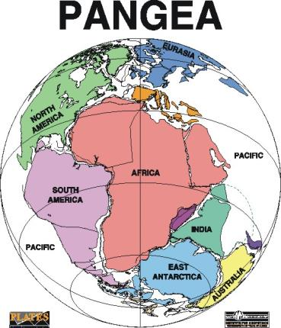
Pangea
1912 – Alfred Wegener
Theory: All of the continents
were connected as one supercontinent
called Pangea.
300 million years ago
(over time drifted apart)

Slide 3
Continental Drift Theory
A theory proposed by Alfred Wegner, that the continents on Earth are floating on a denser layer below. Earths surface is moving or drifting about the surface.
https://www.youtube.com/watch?v=cQVoSyVu9rk
https://www.youtube.com/watch?v=5ppyGg3vRs8

Slide 5
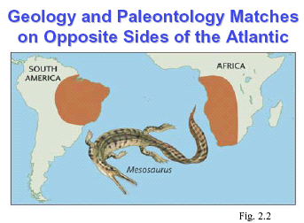

Slide 6
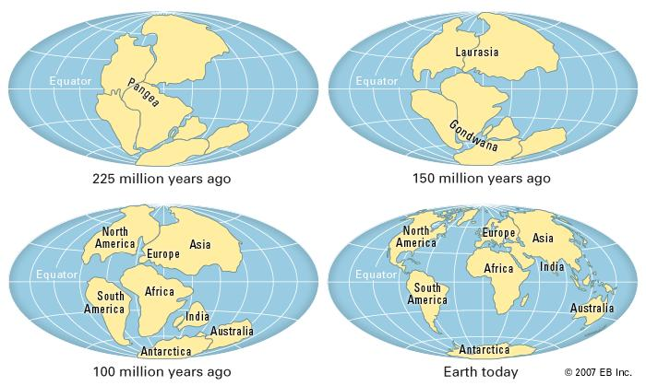

Slide 7
Ice Age and Plate Tectonics
https://www.youtube.com/watch?v=Hf74Sp0Xe6Q&feature

Slide 8
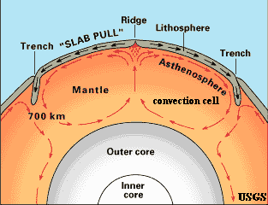
Structure of the Earth
Different Layers
The Lithosphere (earth’s crust – soils, rocks, minerals) is divided into large plates.
Convection currents in the athenosphere move these plates.

Slide 9
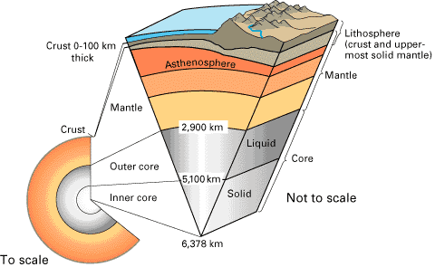

Slide 10
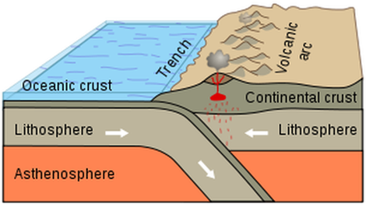
Layers of the Earth
Crust: Rigid surface of the Earth. It can be between 0-100 km thick
Continental Crust: Thicker parts of the crust (above the ocean) mainly granite
Oceanic Crust: Thinner parts of the crust under the ocean, made of basalt.

Slide 11
Layers of the Earth Continued…
Mantle: Between the crust and the core. Largest volume of the earth. Mg, Fe, O, Si are key elements.
The crust and upper mantle are called the lithosphere. (sphere of stone)
Upper Mantle: Solid part of the mantle
Lower mantle: semi-solid and capable of movement (called the asthenosphere).

Slide 12
Layers of the Earth Continued…
Core:
Outer part is liquid - 2300 km thick.
Inner is solid and mostly nickel and iron.
*Believed to control the Earth’s magnetic field.

Slide 13
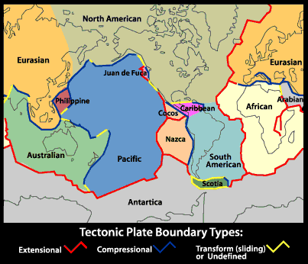
Tectonic Plates
Lithosphere
(broken into large rigid pieces called plates)
Plates
(moving in different directions and at different speeds – 2 cm to 10 cm per year)

Slide 14
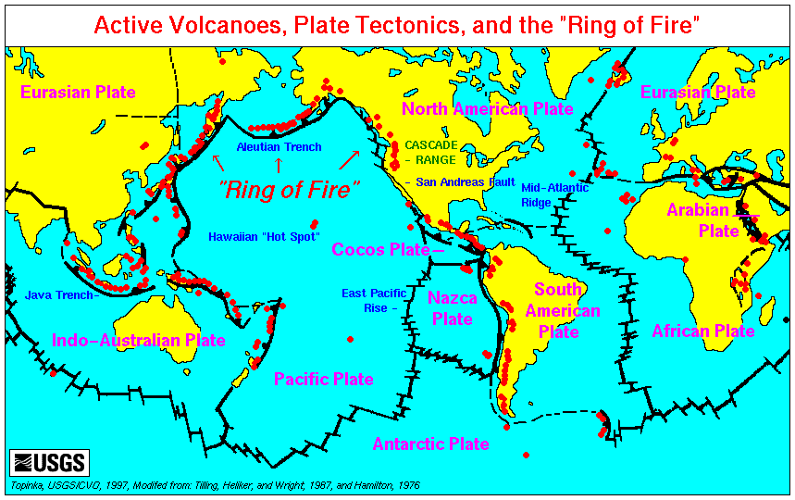
- Plates – segments of Earth’s crust which are being pushed apart or together in precise directions and constant speeds.

Slide 15
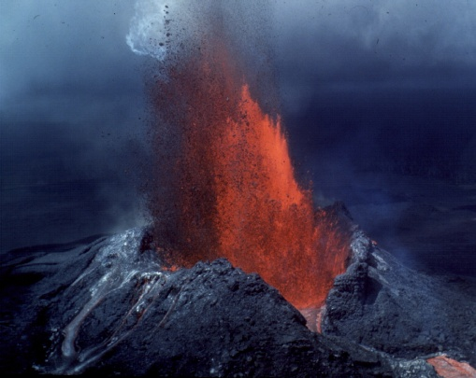
At Plate Boundaries…
Earthquakes
Tsunami
Volcanoes

Slide 16
Plates Meet at Plate Boundaries
3 Main Plate Boundaries.
Convergent Boundary
Divergent Boundary
Transform Boundary

Slide 17
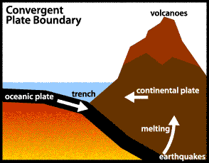
Convergent Boundaries (Subduction Zones)
2 plates coming together (colliding)
Denser Oceanic plate forced under continental plate
(rock in the oceanic plate melts as the plate sinks – then rises up causing volcanic eruptions)

Slide 18
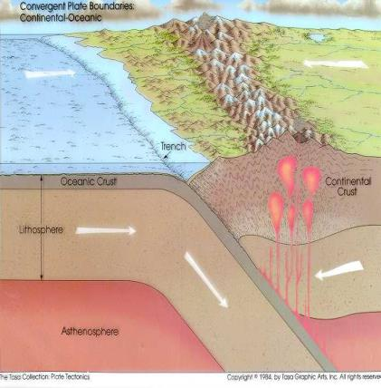
Example: West Coast of South America
Oceanic Nazca Plate colliding with the South American Plate
Formed the Andes Mountains
Deep Trench (off the coast of the Pacific Ocean)
https://www.classzone.com/books/earth_science/terc/content/visualizations/es0902/es0902page01.cfm?chapter_no=visualization

Slide 19
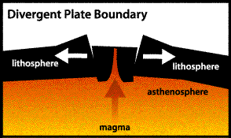
Divergent Plate Boundaries
Plates begin pulled apart
Magma from the mantle rises through the cracks between the plates
Cools and new crust is formed
Earthquakes and Volcanoes occur along these boundaries

Slide 20
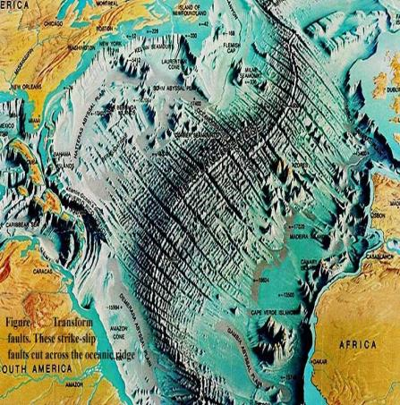
Example: Mid Atlantic Ridge
Over 15,000 km long
Average Height of 3 km
http://earthguide.ucsd.edu/eoc/teachers/t_tectonics/p_seafloorspreading.html

Slide 21
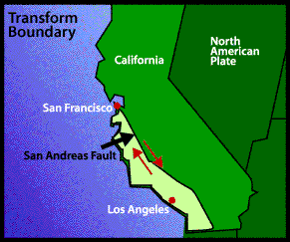
Transform Boundary
Places where plates slide past each other
Cause lots of earthquakes
Example: San Andreas Fault in California
https://www.youtube.com/watch?v=ZxPTLmg0ZCw

Slide 22
Bill Nye – Summary of Plate Tectonics and Continental Drift
http://www.watchknowlearn.org/Video.aspx?VideoID=698&CategoryID=2464

