Slide 1
Marine Biome

Slide 2
What is a Biome?
A biome is a large geographical area of distinctive plant and animal groups, which are adapted to that particular environment.
There are three things that distinguish one biome from another:
Climate
Vegetation
Animal Life

Slide 3
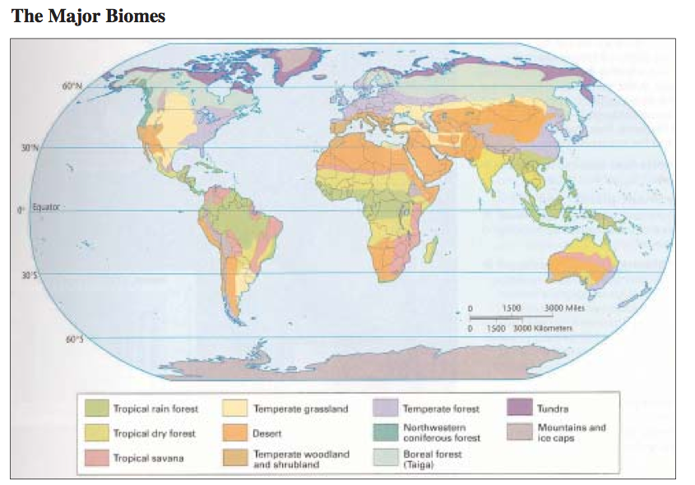

Slide 4
Example of Biomes
Grasslands
Forests
Tundra
Deserts
Aquatic

Slide 5
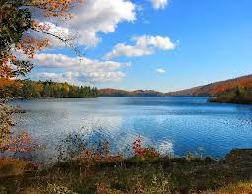
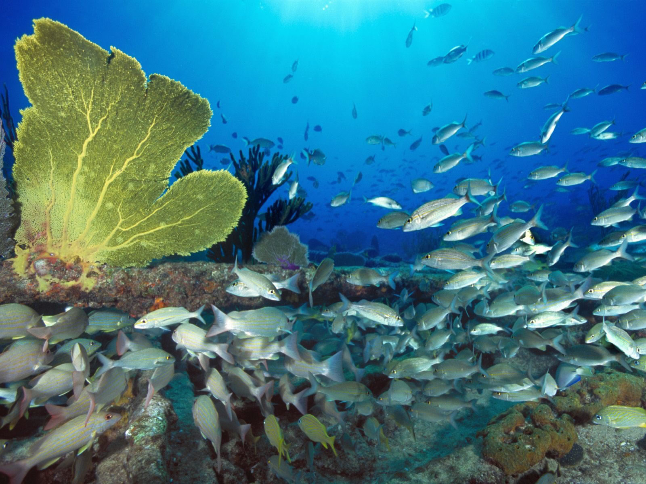
Aquatic Biomes
There are 2 types of aquatic biomes:
1) Freshwater 2) Marine
(lakes, streams, rivers) (oceans, coral reef, estuaries)

Slide 6
The Marine Biome
The marine biome is the largest of all Earth’s Biomes. Since the ocean is so large, there are many different areas of this biome that contain differing pressures, temperatures, and amounts of sunlight.
Due to these differences, different marine life can live in different areas of the ocean.
Because the organisms differ depending on the region of the ocean, we can separate the marine biome into smaller biomes, mainly the coast and the open ocean.

Slide 7
Coastal (Neritic) Zone
The oceans can be divided into two main biomes – the deep open ocean and the coastal, or neritic, zone.
Coral reefs in warm, coastal waters are the ocean’s richest habitat. These reefs are built by organisms such as corals with mineral skeletons.
The shallow waters of the coastal zones occupy just 10 per cent of the total ocean area, but are home to 98 per cent of marine life.

Slide 8
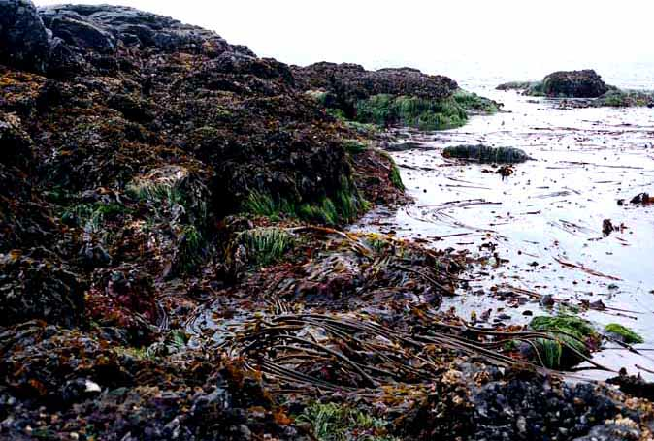
Intertidal Zone
Organisms here are covered by water at high tide and are exposed to air during low tide.
Many organisms here are adapted to living on land and under water.

Slide 9
Estuaries
An estuary is a partially enclosed body of water along the coast where freshwater from rivers and streams meets and mixes with salt water from the ocean
Estuaries and the lands surrounding them are places of transition from land to sea and freshwater to salt water
The tidal, sheltered waters of estuaries also support unique communities of plants and animals especially adapted for life at the margin of the sea.

Slide 10
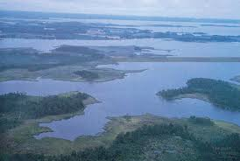
Estuaries

Slide 11
Open Ocean Zones
The “Open Ocean Zones” are split into three zones:
Euphotic (upper) zone
Bathyal (middle) zone
Abyssal (lower) zone

Slide 12
Euphotic (Upper) Zone
Jellyfish, fish such as herring, mackerel, and sharks, and crustaceans such as the lobster all inhabit shallow and surface waters.
The open ocean can be divided into several layers, each with different levels of light, oxygen, and water temperature.
The upper waters, or euphotic zone, down to 200 m (660 ft) are warm (up to 25°C or 77°F), sunlit, and rich in oxygen.

Slide 13
Bathyal (Middle) Zone
Creatures such as this brittlestar, squid, and hatchetfish inhabit the bathyal zone, or mid-depths, between 200–2,000 m (660–6,600 ft).
Some sunlight penetrates the upper bathyal zone down to about 1,000 m (3,300 ft).
The water temperature may be about 5°C (41°F). No light reaches the dark zone beyond, where temperatures fall to -2°C (28°F).
Notes:
https://www.youtube.com/watch?v=Myhp8ifW6ig
https://www.youtube.com/watch?v=XmjflLIB9J4

Slide 14
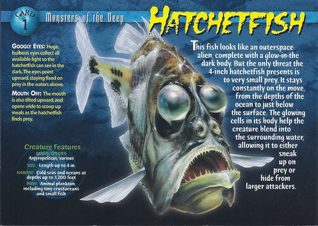

Slide 15
Abyssal (Lower) Zone
The pitch-black, ice-cold abyssal zone below 2,000m (6,600 ft) is home to fish such as the fangtooth.
Animals that live in these vast abyssal waters have to be able to cope with immense water pressure and freezing temperatures.
Some parts of the ocean drop off to depths of 10,000 m (33,000 ft) or more; this region is called the hadal zone.
Notes:
https://www.youtube.com/watch?v=_lOwi6upg4I

Slide 16
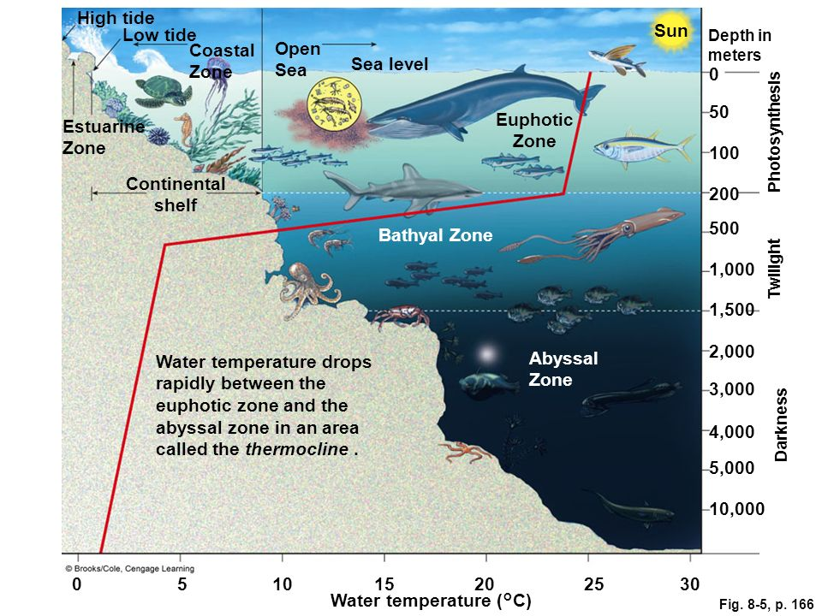

Slide 17
