Slide 1
The Importance of Coastal Zones to Humans

Slide 2
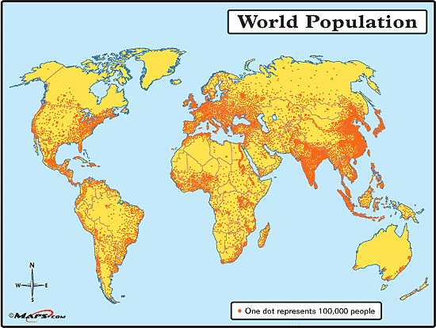
Where do people live?

Slide 3
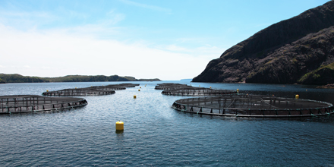
Benefits of Coastal Areas
Most Marine Resources (fossil fuel and exploitable marine species) are found in coastal zones
Water suitable for aqualculture

Slide 4
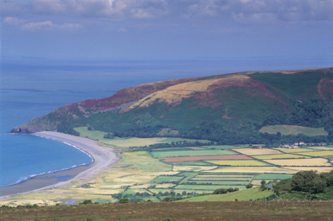
Benefits of Coastal Areas
Terrestrial Subsystem Rich in Resources
Good Farmland
Valuable Timber Species
Minerals such as coal

Slide 5
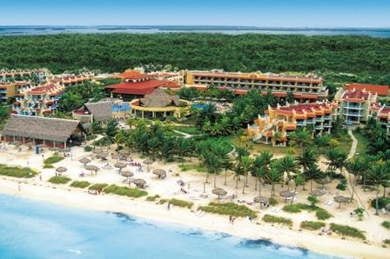
Benefits of Coastal Areas
Tourism
People are drawn to beaches, water sports, yachting,etc.
Pristine coastal areas can help to develop a healthy tourist industry.

Slide 6
Where do people live?
60 percent of the human population currently reside within 60 km of a shoreline, and that proportion is expected to rise to 75 percent by the year 2020
Two-thirds of the world’s largest cities are located on the coast.
Development of the terrestrial subsystems of the Earth’s coastal zones will proceed at a rapid pace, producing changes to natural coastlines.

Slide 7
World Population Increasing…
Ship traffic will increase to service larger markets.
There will be a higher demand for resources—both marine and terrestrial.
http://www.worldometers.info/

Slide 8
Problems…

Slide 9
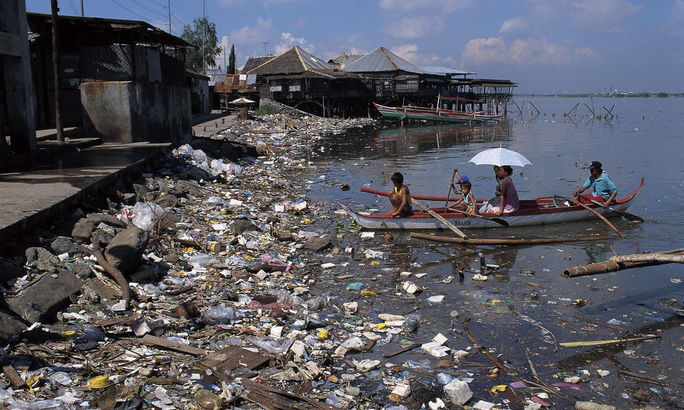
Pollution

Slide 10
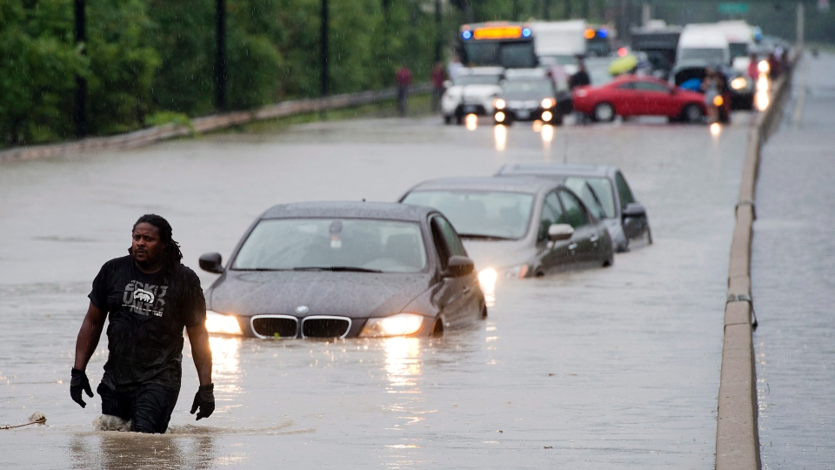
Climate Change
Rise in Sea Level
Threaten low-lying coastal communities
Increased Storm Severity and Frequency
Severe Flooding
Extend further inland than in the past

Slide 11
Sea Level Rise Video
http://www.windows2universe.org/earth/changing_planet/sea_level_rising_intro.html

