Slide 1
Human influences on coastal zones

Slide 2
Five key concerns
Overharvesting of Fisheries
Habitat Degradation and Destruction
Pollution
Global Climate Change
Human Population Growth

Slide 3
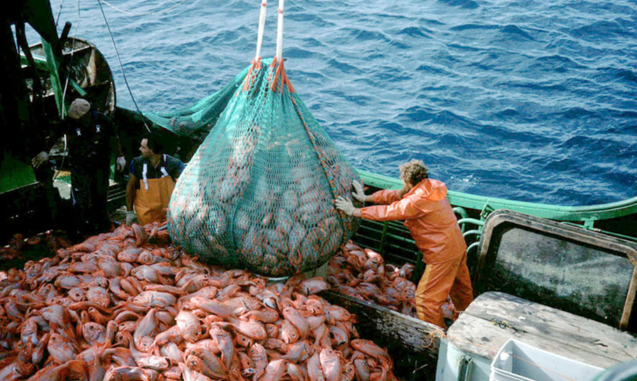
Overharvesting of Fisheries
Extinction of species
Economic repercussions
Fishers/Fish-plant workers put out of work
Shipbuilding, maintenance, fishing gear, trucking, warehousing
Overfishing of one fish = negative effects on apparently unrelated species
Ex: Depletion of Cod Stocks = a large population of seals looking for alternative food sources = a negative effect on wild Atlantic salmon populations.

Slide 4
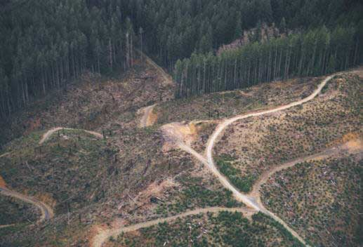
Habitat Degradation and Destruction (physical)
Removal of sand and gravel from shore areas
Increased building of new infrastructure (piers, houses, etc.)
Clear-cutting of forests
Damage to seafloor by draggers

Slide 5
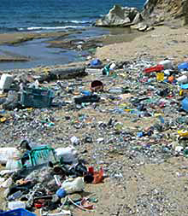
Pollution
Untreated Human Sewage
Toxic Wastes from industries
Runoff (road salt, pesticides, fertilizers, oil products from vehicles)
Oil spills

Slide 6
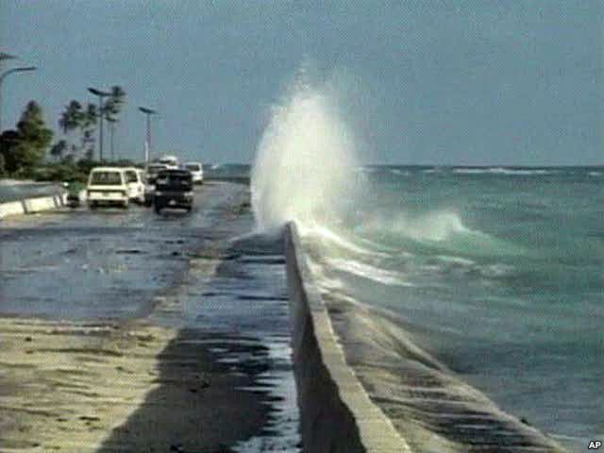
Global Climate change
Change in water temperature
Rising sea levels
Melting of land based ice sheets
Expansion of ocean water due to its rising temperatures
Increased storm frequency and severity

Slide 7
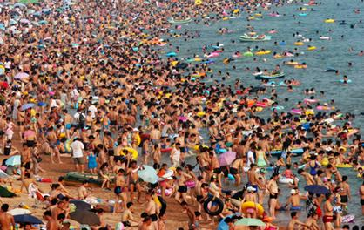
Human Population growth
More people require more space
More wastes/pollution
Degrades coastal zone environment

