Slide 1
Fun Ocean Facts and Properties of Water

Slide 2
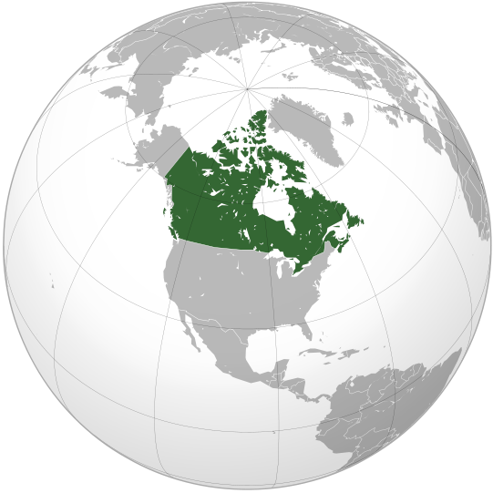
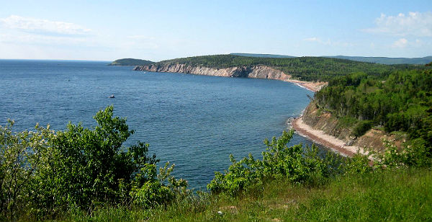
Ocean Facts and Figures
Canada has the world’s longest coastline with a length of 244,000 km. If stretched out as a single, continuous line, this coastline would circle the Earth more than six times!

Slide 3
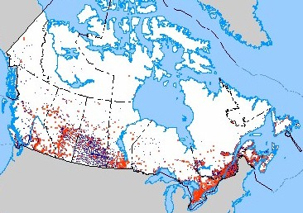
About 7 million Canadians live in coastal communities, where many depend on the coast and the sea to make a living.

Slide 4
In 1990, a severe storm washed 39,466 pairs of Nike sneakers overboard. Data was collected based on where the shoes washed up, and computer models were made to study ocean currents.
The heaviest crustacean ever caught weighed 20.1kg (44lbs) and was caught off of Nova Scotia. The lobster measured 1.07m in length from the tip of the largest claw to the tail.
The total marine fish catch in 1950 was about 14 million tonnes. By 1994 it had risen to about 73 million tonnes.

Slide 5
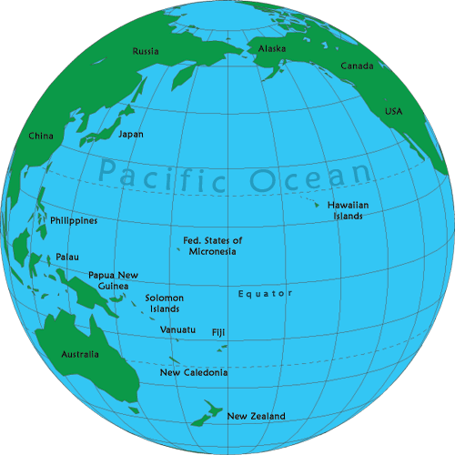
The ocean covers nearly two thirds of the Earth’s surface. The Pacific Ocean alone covers more of the Earth’s surface than all the landmasses put together.

Slide 6
Two-thirds of the Earth’s landmasses are north of the equator. The southern hemisphere is often called “the ocean hemisphere”.
The oceans contain over 86 % of all the water on our planet.
The water in the oceans has been there for about 3 billion years. As a result, it has been mixed thoroughly over one million times. Because of all this mixing, the amount of chemical elements (salts) is the same no matter where a sample is taken from.

Slide 7
Review – Bodies of Water
Ocean – The great body of salt water that covers about three fourths (3/4) of the Earth’s surface. This “great ocean” is divided up into smaller bodies of water and given the common names “Atlantic, Pacific, Indian, etc”.
Seas – Divisions of the ocean marked off by land boundaries.

Slide 8
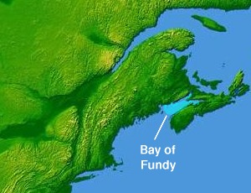
Bays – A body of water forming an indentation of the shoreline. It is smaller than a gulf but larger than a cove.

Slide 9
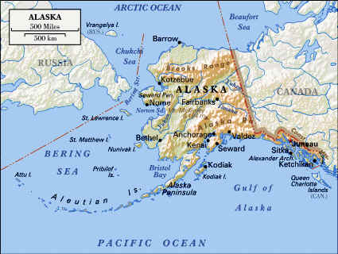
Straits – A narrow passage of water connecting two large bodies of water. Example : Bering Strait.

Slide 10
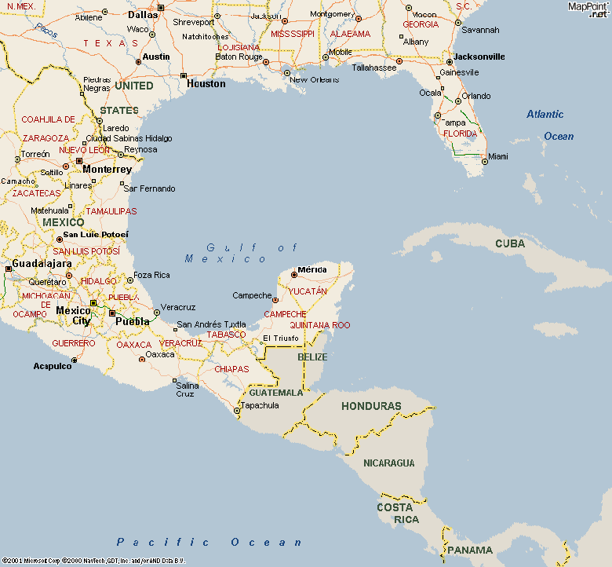
Gulfs – A portion of an ocean or a sea partly enclosed by land. Example : The Gulf of Mexico.

Slide 11
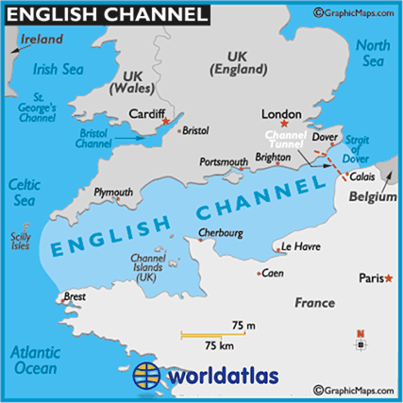
Channels – A wide strait between a continent and an island. Example : The English Channel.

Slide 12
Crazy Water Properties
Water is truly a remarkable substance. It is the only substance that is found abundantly on Earth’s surface in all three states (solid, liquid, gas). Many of water’s unusual properties can be attributed to its chemical structure. What most of us consider normal behaviour for water is most unusual for nearly all other substances!

Slide 13
Wringing out Water on the ISS
https://www.youtube.com/watch?v=o8TssbmY-GM&feature=youtu.be

Slide 14
Water has the highest heat capacity of all substances. This means that it can absorb a lot of heat without raising its own temperature much. Many other substances, such as sand, have a very low heat capacity.
Water is called the “universal solvent” because it can dissolve many substances.
Water expands when it freezes (when it changes from a liquid state to a solid state). Most other substances contract when they freeze.

Slide 15
Water has a low viscosity (it flows very easily) as opposed to cold molasses, which has a very high viscosity (the liquid is very “thick”).
Most liquids freeze from the bottom up. Water freezes from the top down.
Water has an unusually high freezing point and boiling point. Water is a liquid at room temperature, whereas similar compounds are gases.
Water is very transparent for a liquid.
Increasing pressure raises the melting point of nearly all solids. Increasing pressure lowers the melting point of ice.

Slide 16
More Facts and Figures…
Over 145 of the world’s nations are coastal.
The majority of the world’s population lives within 200 km of a coastline. In Nova Scotia you can never go farther than 57 km from the coast!

Slide 17
In the United States, only 17% of the total land area is made up of coastal communities. However, half of the country’s population lives there!
More than 90% of trade between countries is carried by ships.
Over half of the world’s oxygen supply is made in the ocean.

Slide 18
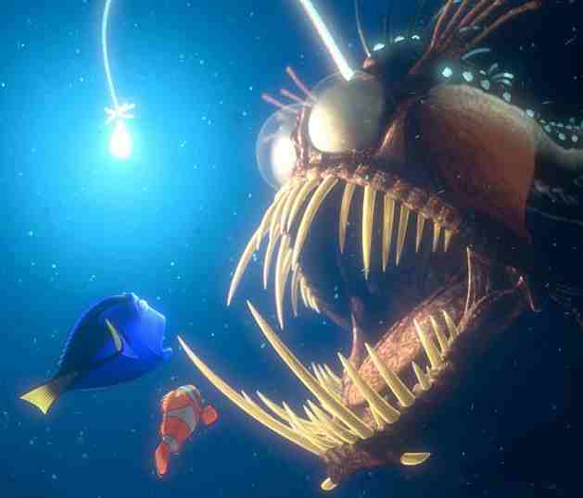
Though coastal areas represent 15% of the ocean’s area, they are the primary areas for marine life.
90% of life in the seas lives in the upper 30 metres of the ocean.

Slide 19
Of all the living space on the planet, 99% is actually in the ocean.
The ocean is home to 50% of all the species on Earth.

