Slide 1
https://www.bostonglobe.com/news/world/2015/03/30/earthquake-generates-tsunami-off-papua-new-guinea/70nJSZWzECLXwTsLogJ1PM/story.html

Slide 2
Earthquakes

Slide 3
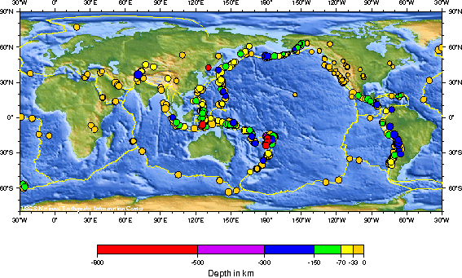
Pattern of Earthquakes in September, 2010

Slide 4
Plate Tectonics
Description of the movements of pieces of Earth’s lithosphere on less rigid mantle rocks and the effects caused by plate motion and plate formation.
Responsible for distribution
Earthquakes
Active volcanoes
Mountains

Slide 5
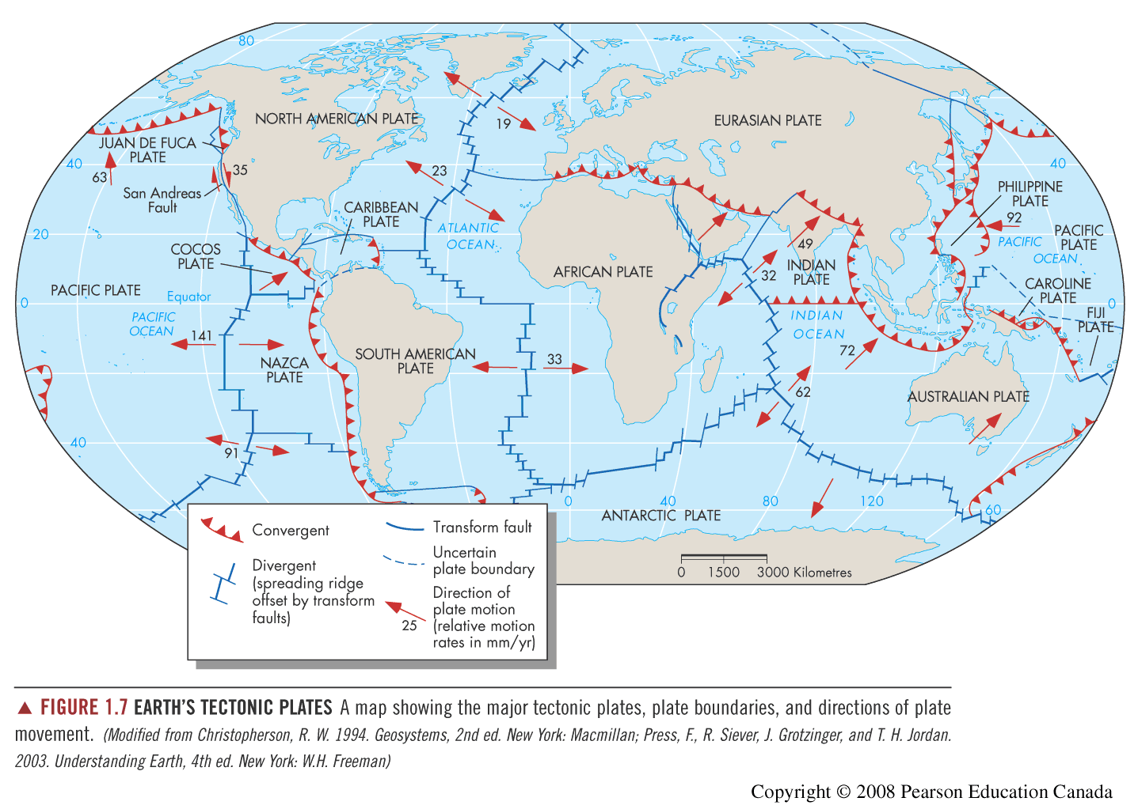

Slide 6
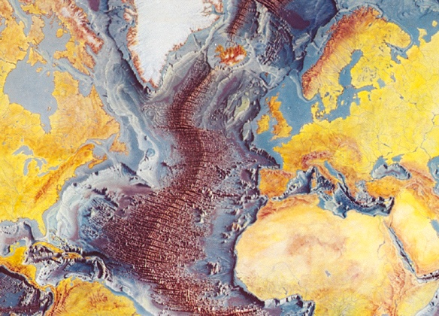

Slide 7
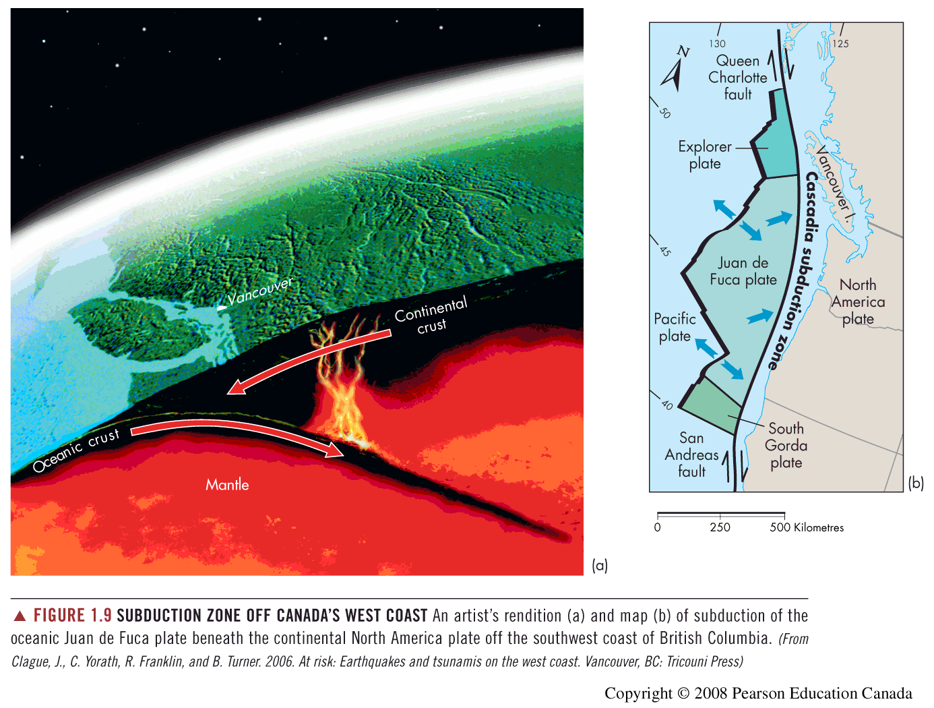

Slide 8
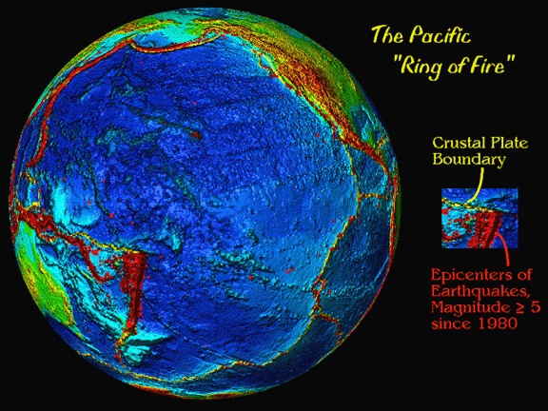

Slide 9
At Plate boundaries:
Earthquakes
Tsunami
Volcanoes

Slide 10
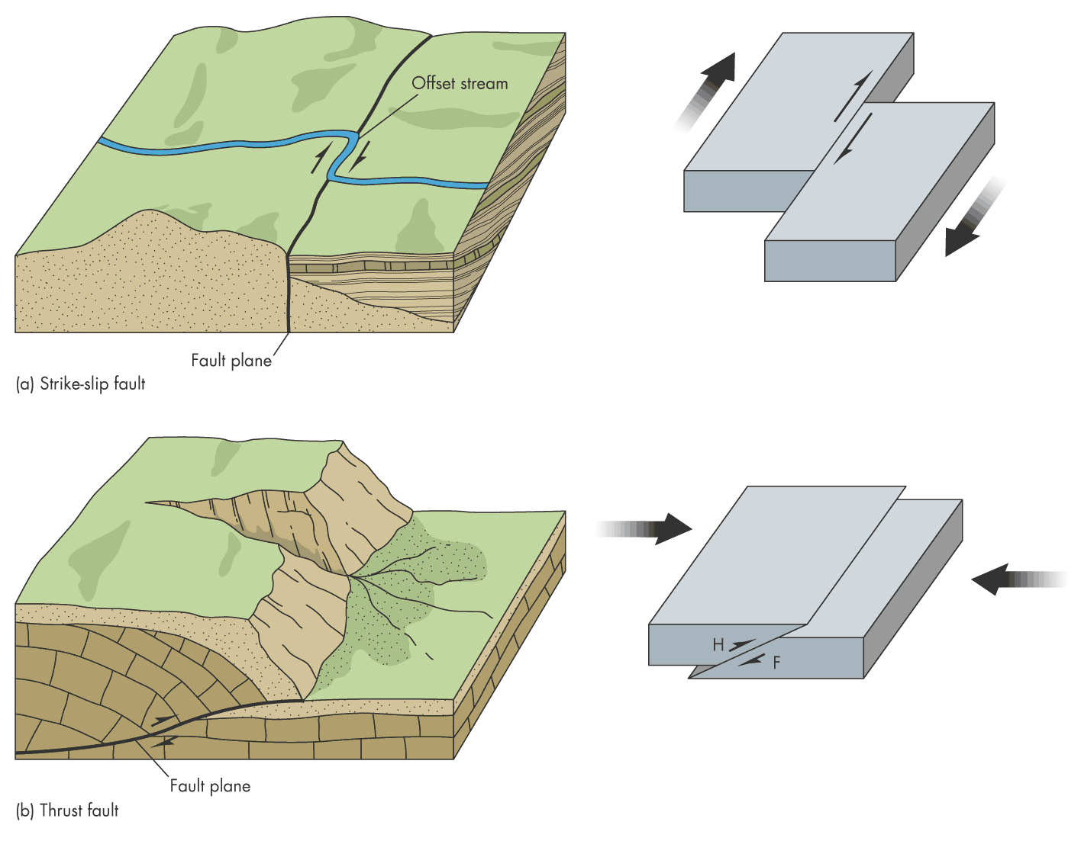
(Right lateral strike slip)
Transform fault
Fig. 2.12
Convergent (subduction) fault

Slide 11
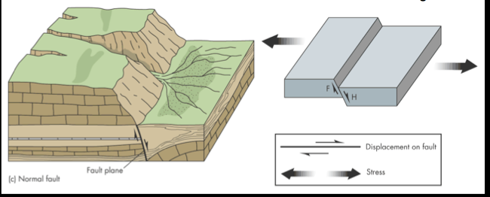
Divergent fault

Slide 12
The San Andreas Strike Slip Fault:
Does this fault show a right lateral or left lateral offset?

Slide 13
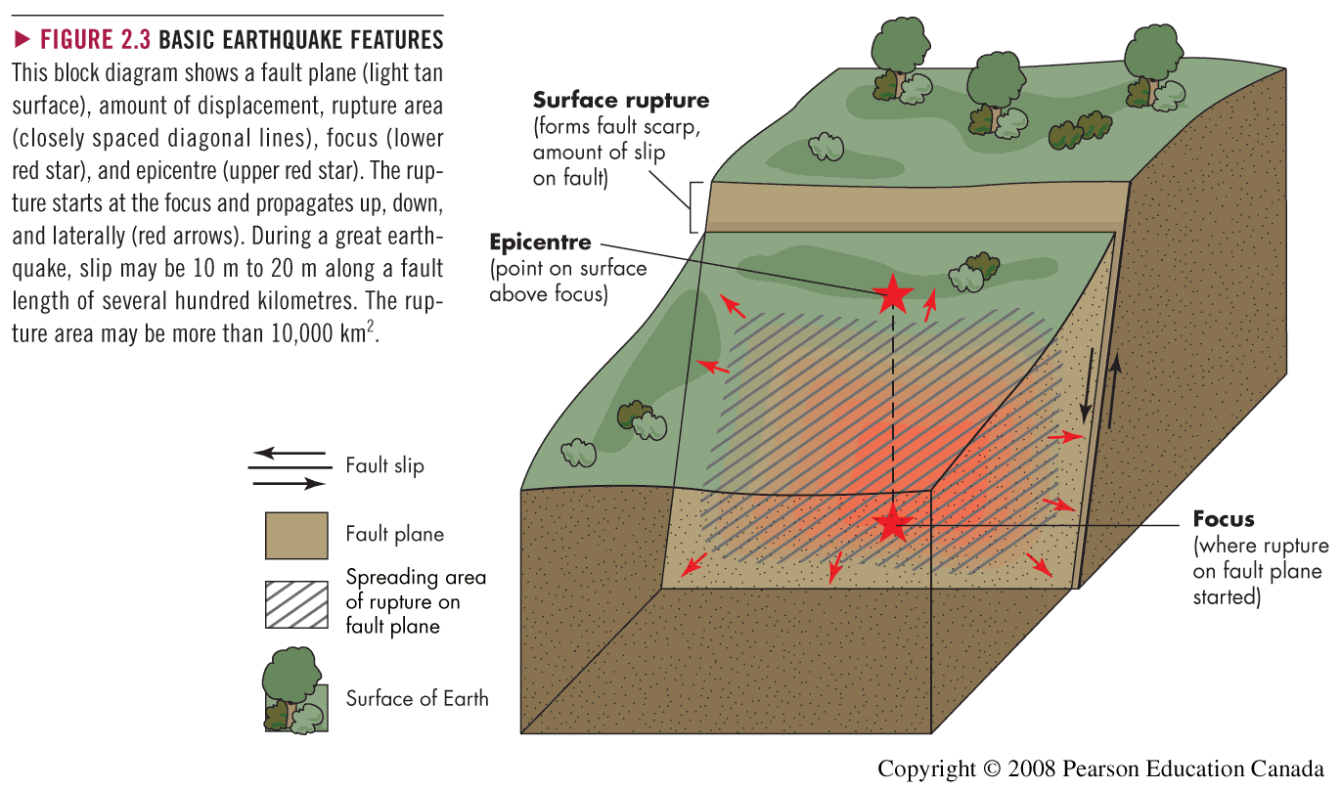

Slide 14
Definitions
Fault: fracture that has motion (displacement) along it
Seismic: related to earthquakes
Seismograph: instrument that records vibrations
Seismogram: the record itself
Seismic wave: any of the waves that are generated by an earthquake
Seismic moment: direct measure of the energy radiated during an earthquake

Slide 15
Types of Waves
Body waves (underground) – travel faster
“s” waves (perpendicular to direction of travel)
“p” waves (compressional) - faster
Surface waves
Love (horizontal motion)
Rayleigh (up and down & side to side in same direction of travel)
http://www.geo.mtu.edu/UPSeis/waves.html

Slide 16
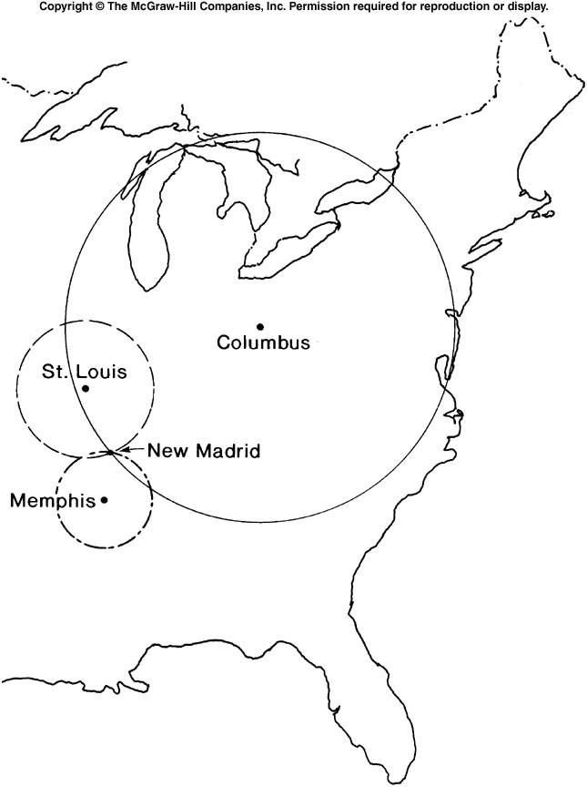
3 seismometers are needed to triangulate the position of the epicenter (and focus)

Slide 17
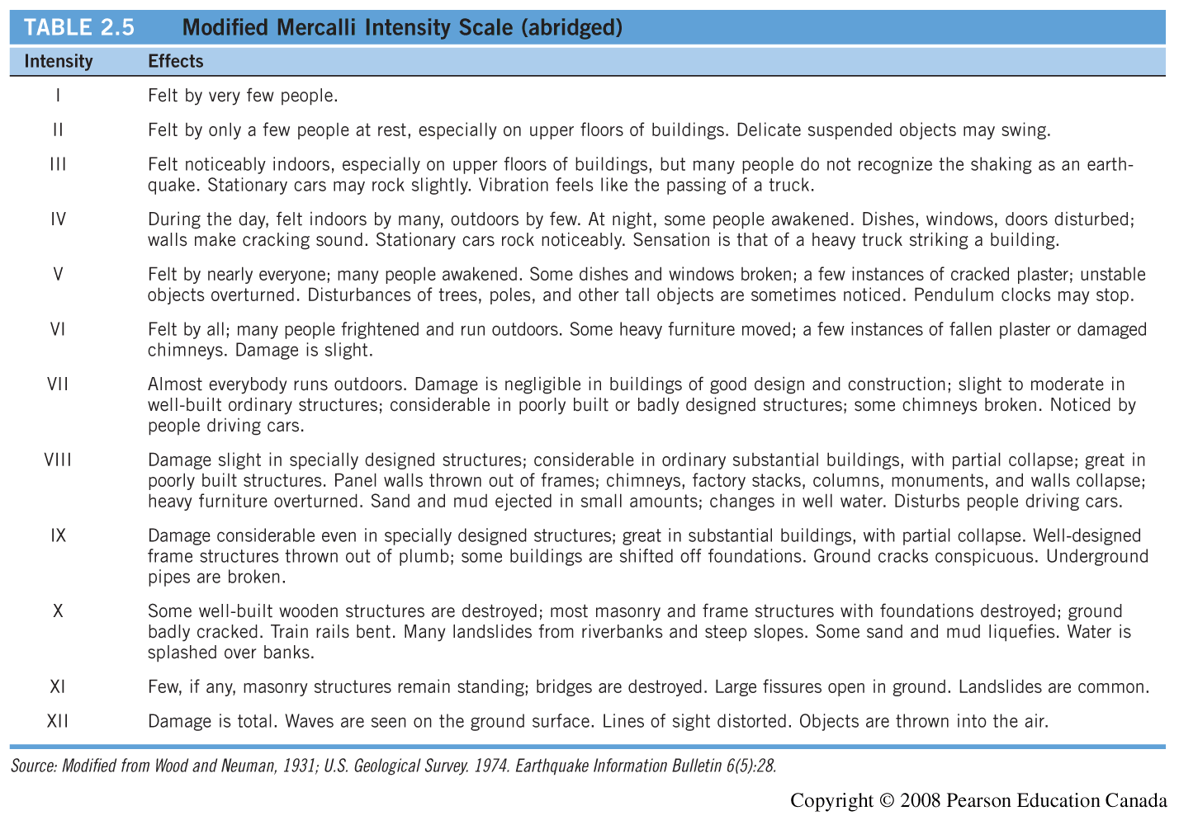

Slide 18
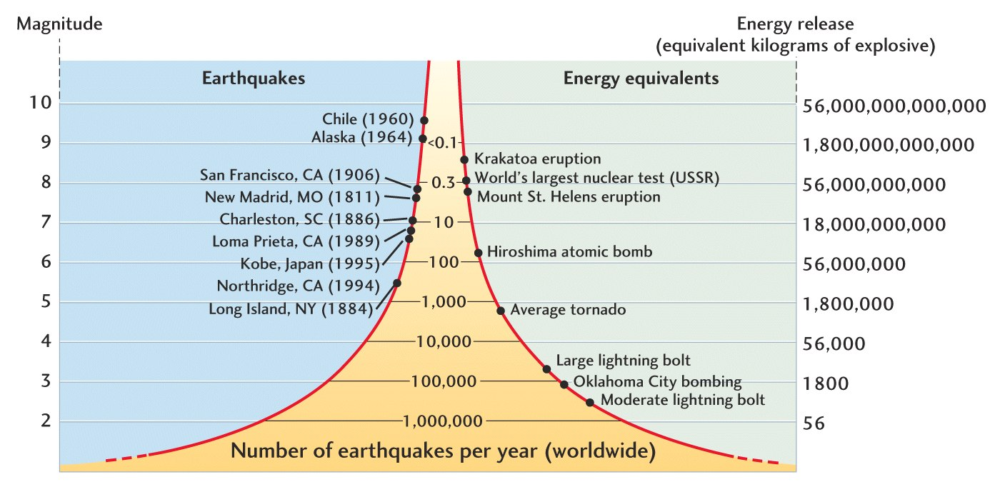
Earthquakes – Moment Magnitude Scale

Slide 19
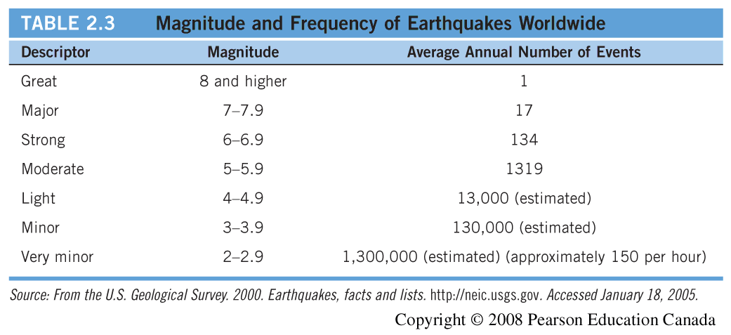

Slide 20
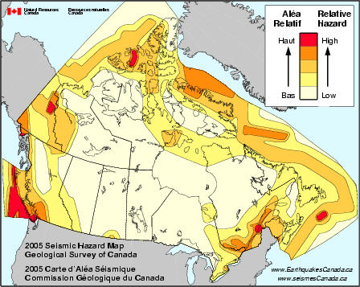

Slide 21
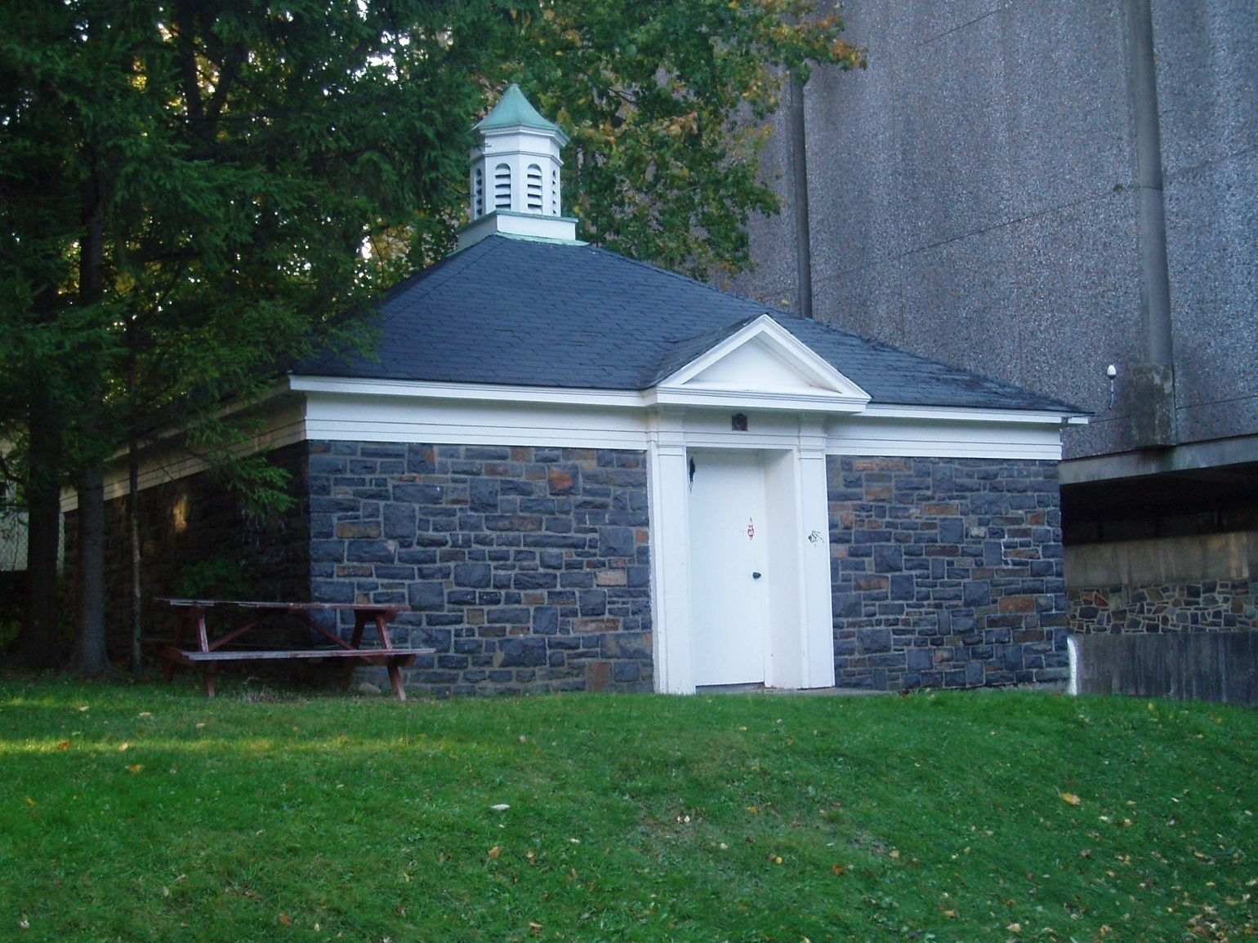
The Dalhousie Seismic Hut
1. Active monitoring…
First
Installed
1915

Slide 22
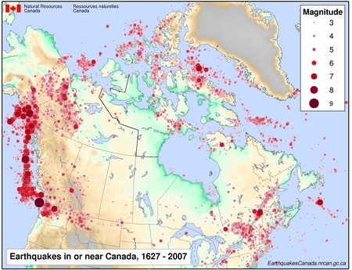

Slide 23
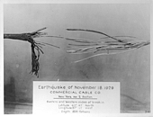
Grand Banks Earthquake
November 18, 1929 at 5:02 pm Newfoundland time
Moment Magnitude (Mw) 7.2
Depth 20 km
Damage in Cape Breton
Large submarine slump
Broke 12 transatlantic cables
Tsunami struck Burin Peninsula

Slide 24
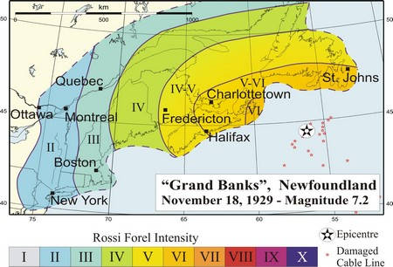
Use historical records/archives to generate a felt map
(early 20th century):
http://earthquakescanada.nrcan.gc.ca/historic_eq/20th/1929/1929_e.php#Recent%20Research

Slide 25
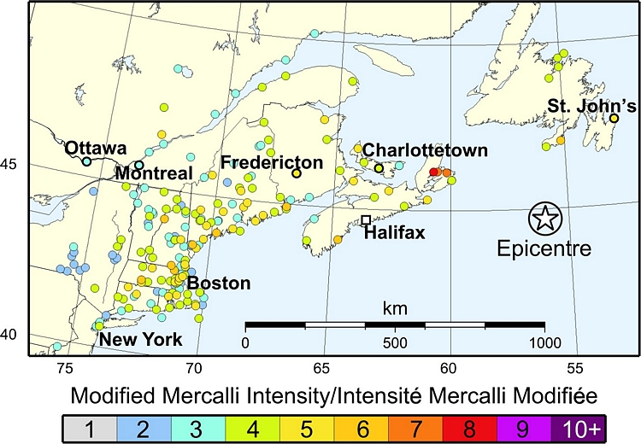
A revised felt map for the 1929 earthquake:

