Slide 1
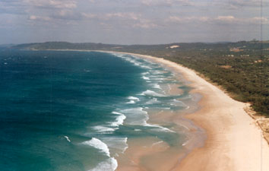
Defining Coastal Zones

Slide 2
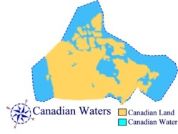
Defining Coastal Regions
An understanding of coastal zones is particularly important to those living in coastal regions.
Canada has the largest coastline in the world, so it is important to look at our coastal zones and what happens there.

Slide 3
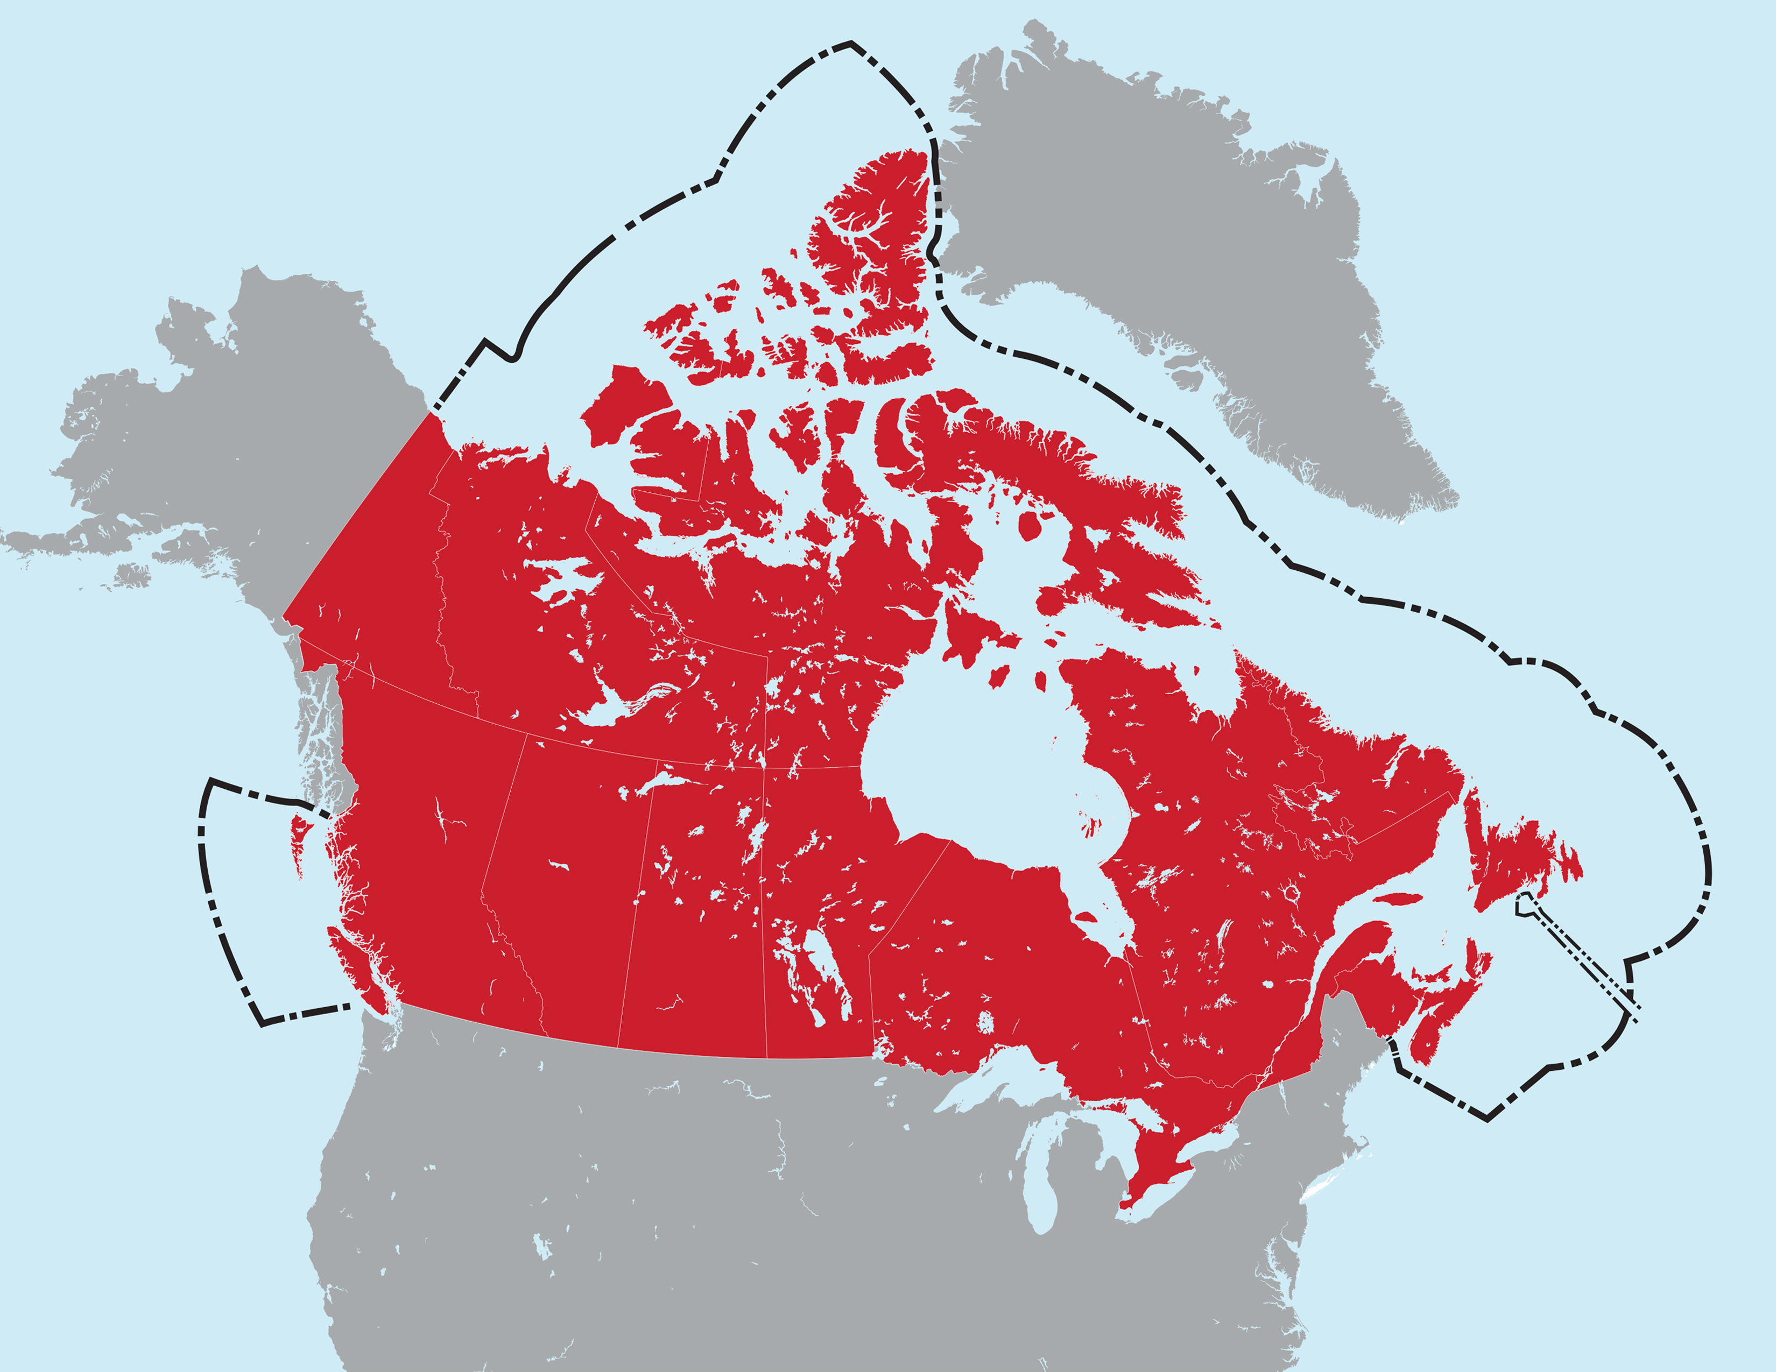
What makes a coastal zone?
- In matters relating to the fishery, the term “integrated coastal zone” may refer to an area extending to or beyond Canada’s 200-mile exclusive economic zone (EEZ).
- The limits of the integrated coastal zone can, depending on the situation, extend from the inland limit of coastal watersheds to the seaward edge of the EEZ. (can extend a long way inland)
Notes:
over which a state has special rights regarding the exploration and use of marine resources, including energy production from water and wind

Slide 4
Coastal Zone Subsystems
Marine Subsystem
Coast Subsystem
Terrestrial Subsystem
** Each subsystem has its own characteristics, resources, and set of problems.

Slide 5
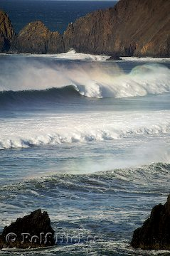
Marine Subsystem
Oceanic component of a coastal zone. (part under salt water)
Characteristics:
- Water depth, salinity, temperature
- Waves, tides, currents
- Seabed composition
- Diverse marine habitats

Slide 6
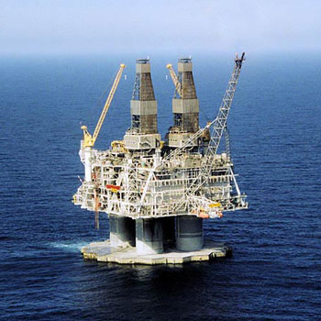
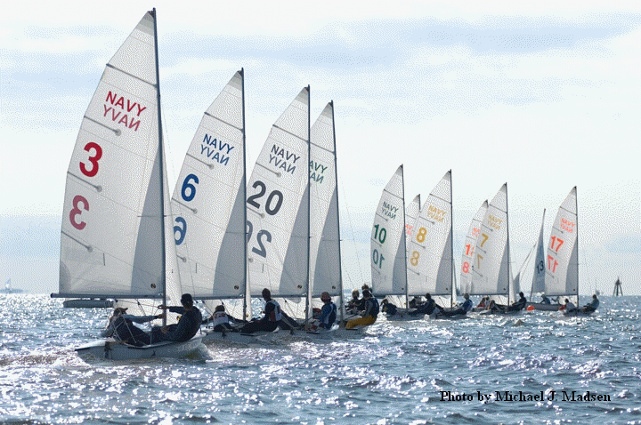
Marine Subsystem
Resources:
- Fisheries, oil, gas
- Tourism, recreation
- Navigation
- Waste disposal

Slide 7
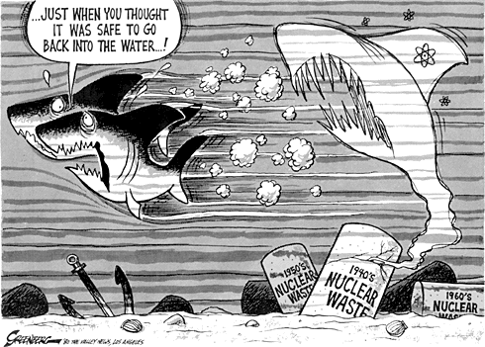
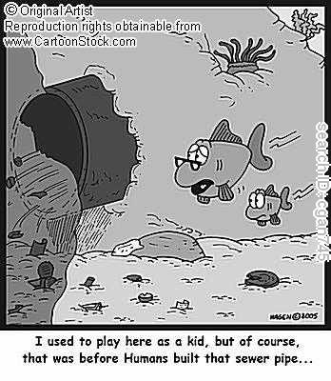
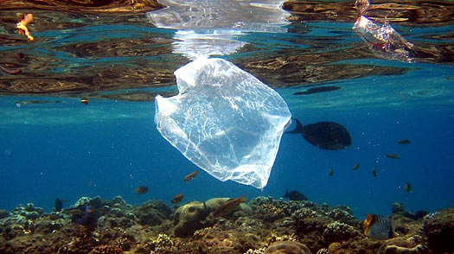
Marine - Problems

Slide 8
Marine SUbsystem
Problems:
-Depletion of plant/animal populations due to habitat loss
- Space conflicts
- Deterioration of water quality from waste and oil spills

Slide 9
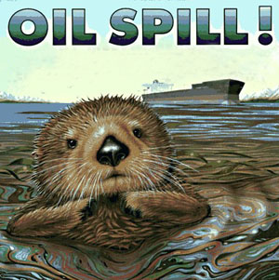
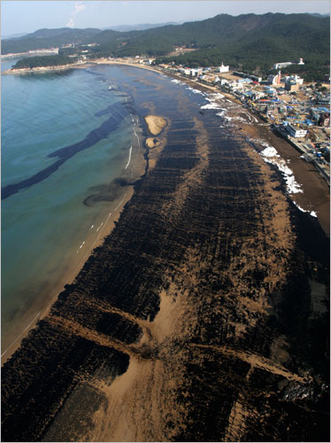
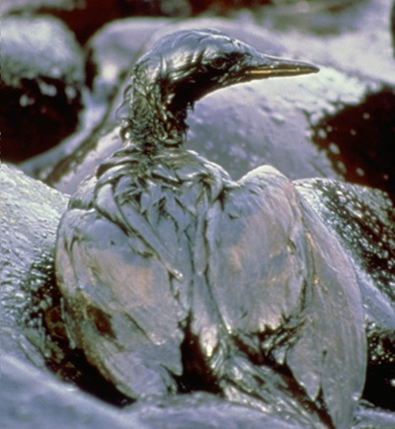
https://www.youtube.com/watch?v=-OVNd6Fa9fg

Slide 10
Terrestrial Subsystem
Land where humans and other activity can affect the marine environment
Coastal zones can extend a long way inland. A terrestrial component is included to show that activities taking place within a coastal watershed can directly affect the marine environment through run-off into river systems.
Characteristics:
Landscape
Soil types
Surface water resources
Groundwater resources
Terrestrial habitats (forest, wetland, etc.)

Slide 11
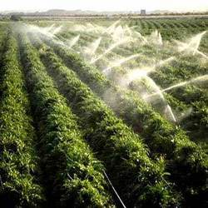
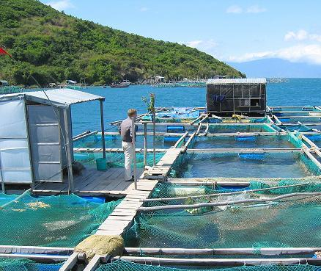
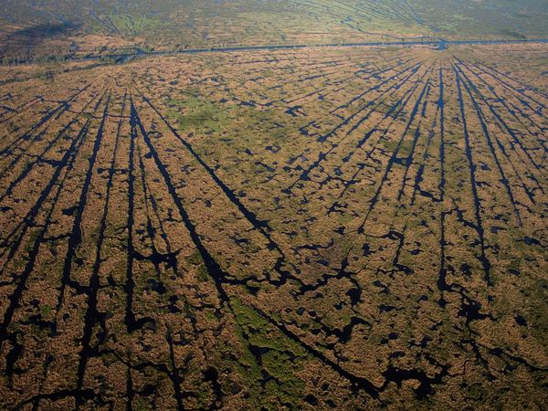
Terrestrial subsystem
Resources:
- Land: logging, mining
- Freshwater: domestic, industrial, irrigation
- Agri/aquaculture
- Human settlements
- Industry facilities

Slide 12
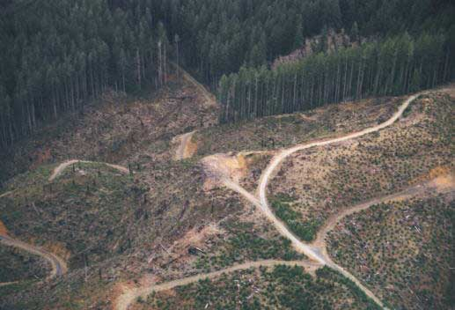
Terrestrial Subsystem
Problems:
Destruction of habitats
Transport of wastes into marine subsystem
Increased possibility of floods
Deterioration of freshwater (availability and quality)

Slide 13
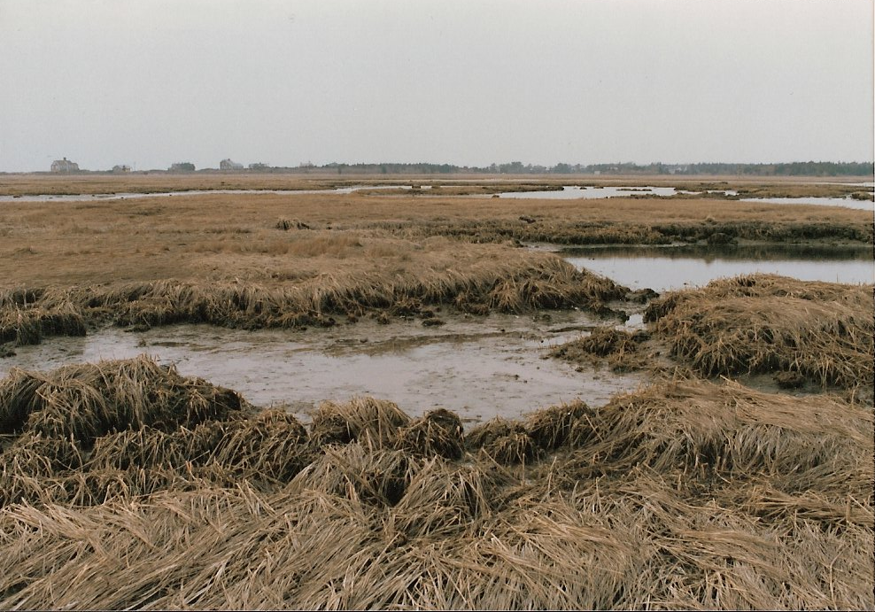
Coastal subsystem
Narrow and dynamic zone between marine and terrestrial subsystem
- Includes the area between the low and high tides (intertidal zone) and the saltwater spray zone.
Characteristics:
Profile (rocky, sandy)
Tidal, wind, wave profile
Possibility of storm surges
Coastal habitat types (rocky, mudflat, etc.)

Slide 14
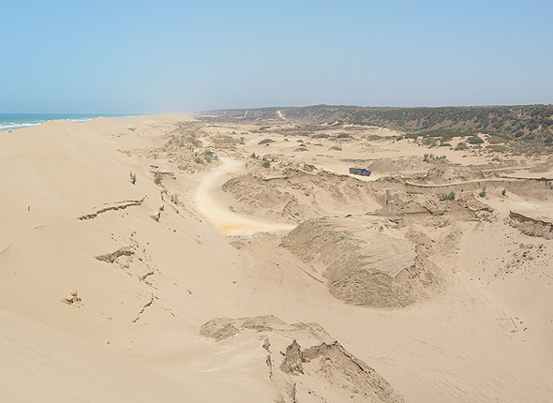
Coastal subsystem
Resources:
Sand and gravel extraction
Tourism, recreation
Human settlements
Port development, industry
aquaculture

Slide 15
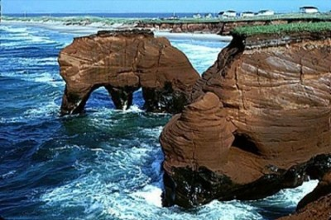
Coastal subsystem
Problems:
- Disturbance and destruction of coastal habitat by mining, logging, settlement,
and infrastructural development
- Loss of shoreline due to accelerated erosion
- Deterioration of water quality

Slide 16
Summarize/illustrate Info
Groups of 3
Choose 1 subsystem (Marine, Coast, & Terrestrial)
Summarize and Illustrate info on a piece of chart paper.
(a concept map may work well)…expand on notes given on powerpoint…

