Slide 1
Coastal Zones around the World

Slide 2
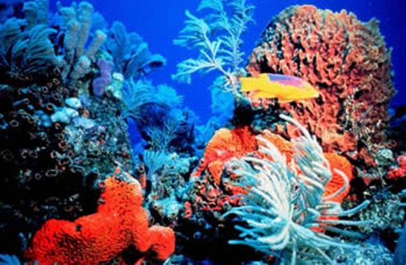
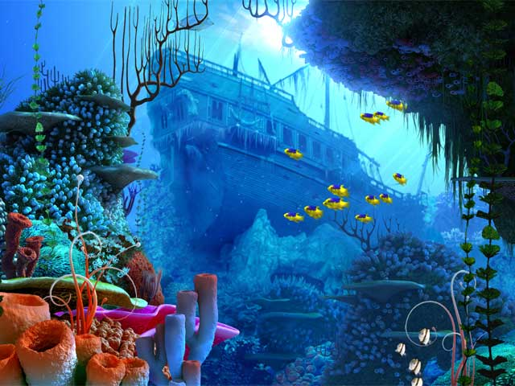
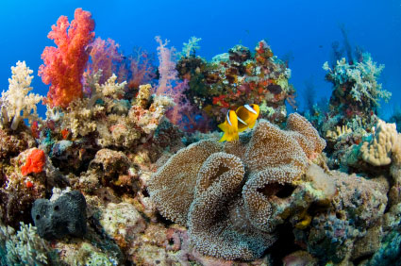
Coral Reefs

Slide 3
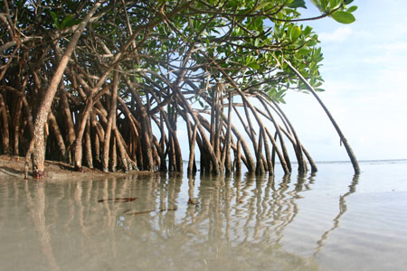
Mangroves
https://www.youtube.com/watch?v=gBuWPaJAqUg

Slide 4
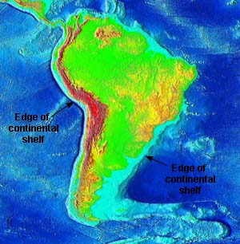
Narrow Continental Shelves
Continental shelf South America

Slide 5
Hyams Beach, Jervis Bay, New South Wales, Australia
The sand on this beach is made almost entirely of quartz making it one of the whitest sand beaches in the world. It is listed in the Guinness Book of Records as having the whitest sand of any beach in the world!

Slide 6
Amalfi Coast, South of Naples, Italy

Slide 7
Jurassic Coast, Dorset, United Kingdom

Slide 8
Kaihalulu Beach, Ulupalakaua, Maui, Hawaii
This beach is found tucked into a tiny pocket cove near Hana Bay.
It is one of very few red beaches in the world, the sand gets its red-black color from the iron-rich crumbling cinder cone hill surrounds the bay.

Slide 9
Pfeiffer Beach, Big Sur, California
When the manganese garnet from the hills surrounding Pfeiffer Beach get washes down to the ocean they turn the sand into a vivid purple color. The further north you go, the more purplish the sand becomes.

Slide 10
Ireland

Slide 11
Phang Nga Bay, Phuket, Thailand

Slide 12
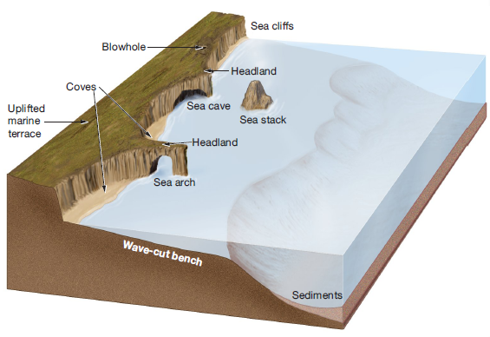

Slide 13
Black Sand Beach, California
This is the result of volcanic activity near a coastline. Black beaches are created when particles weathered from cooled lava wash down to shore.

Slide 14
Milford Sound, New Zealand

