Slide 1
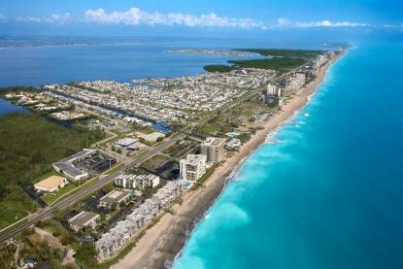
Coastal Zones: Processes and Landforms

Slide 2
Definitions of Coastal Regions:
The shore is the area on the coast which covers the furthest low tide mark to the highest elevation where waves affect (width: a few to hundreds of meters)
The coast extends from the inland edge of the shore as far inland as ocean-related features are found. (width: less than a km to many tens of kms)
The coastline marks the boundary between the ocean and the land

Slide 3
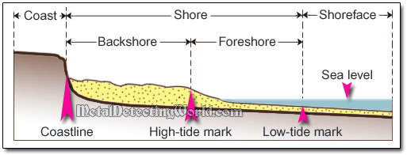

Slide 4
Backshore and Foreshore
The backshore refers to the part of the coast that is above the high tide line
The foreshore refers to the part of the coast that is covered at high tide; exposed at low tide
The foreshore also can be called the intertidal zone

Slide 6
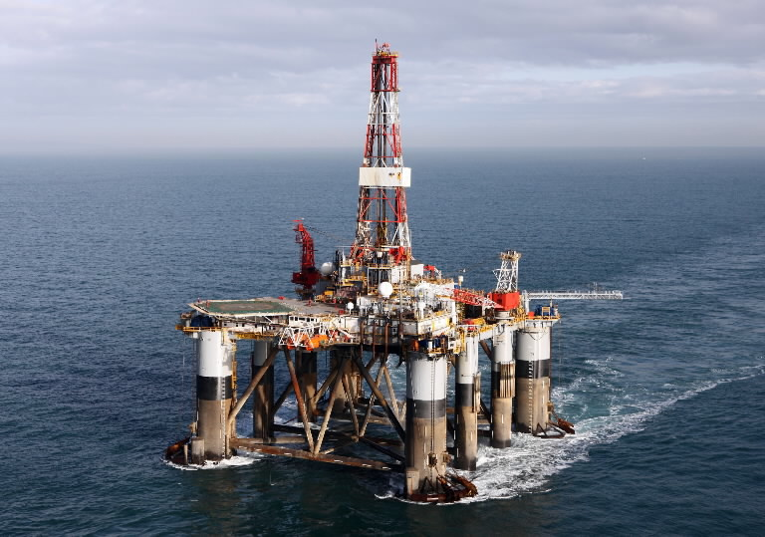
Backshore and Foreshore
The nearshore refers to the area between the shoreline (water’s edge) and the zone where waves are breaking.
Offshore refers to the area where water is too deep to affect waves.
Offshore Oil Drilling

Slide 7
Coastline (vs) Shoreline
Read over the statistics of coastline and shorelines for each province and territory in Canada.
Answer the questions.

Slide 8
The Beach
The beach is the part of the coastline which has sediment deposited (i.e. sand)
The berm is the dry part of the beach, above the high tide mark
Off the shoreline is the longshore bar (known commonly as the sand bar) is formed at certain points of the year
It is exposed to the air during low tides

Slide 9
Composition of the Beach
Beaches are composed by material that is available in that geographical location
For example, in Joggins, Nova Scotia the cliffs surrounding the beach are made of thin, brittle rocks (known as shale) which form the beach.
If there is a lot of fine material in a region the beaches can be made of mud or sand; if there are volcanoes then the beach is made of weathered volcanic rocks (basalt)

Slide 10
Movement of Sand
Sand can move both up and down the beach as well as side to side (longitudinally)
Sand moves up and down the beach due to breaking waves
A wave swashes (breaks and moves in) and then backwashes (draws back)

Slide 11
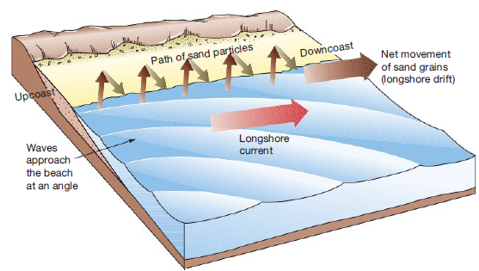
Movement of Sand (Cont’d)
Longitudinal motion of sand takes place because of an along shore current
Waves bend as they approach the shore (rarely they hit the shore straight on)
This creates a zig zag pattern

Slide 12
Features of an Erosion Coast
Any land that sticks out from the coast will bear the brunt of the energy from breaking waves. We call these areas headlands
Wave action can create sea cliffs or even sea caves from the repeated swashing motion
Some waves can wear a tunnel through part of the sea cliff and form a sea arch
This ultimately can wear away forming a sea stack, which is a high tower of sea cliff

Slide 13
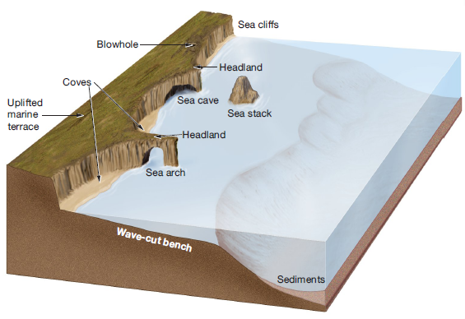

Slide 14
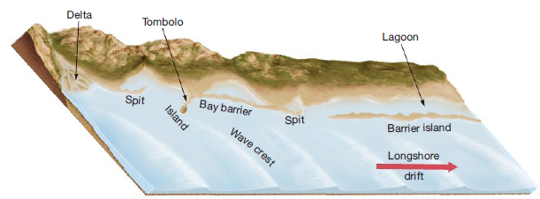
Features of Depositional Shores
A shore that can build up its sediment (sand) is said to be a depositional shore

Slide 15
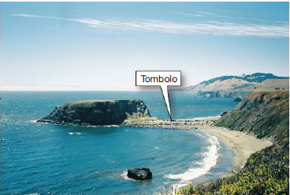
Features of Depositional Shores
A spit is a linear ridge that sticks out in the direction of the longshore current; the end of the spit will curve into the bay as it gets bent inward by currents
A bay barrier is a barrier that separates a bay from the open ocean. These form when the currents are not strong enough to keep the mouth of the bay open
A tombolo is a ridge of land which connects an island or sea stack to the mainland

Slide 16
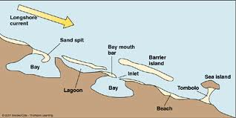
Features of a Depositional Shores
Longshore current: currents of water flowing parallel to the shore. They are formed by waves striking the shore at an angle. Carry sand and other sediments.

Slide 17
Risks to Our Coasts
Our shores are at risk due to various human activities which can directly and indirectly affect erosion processes (That is, processes where the coast is worn away)
Climate change and sea level rise
Loss of the Berm (loss of sand)
Interference in the longshore current

Slide 18
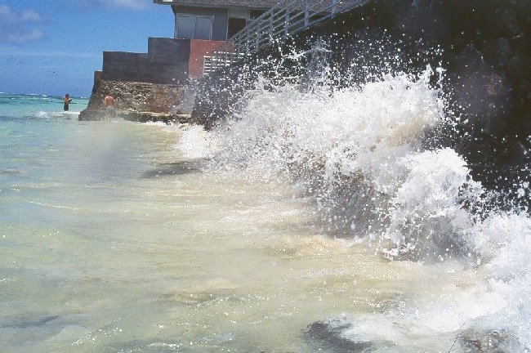
Hard stabilization
Refers to human efforts to build structures that will slow or stop the damage to our coast lines
It is also called coast armoring of the shore
It can lead to many predictable, yet unwanted, effects

Slide 19
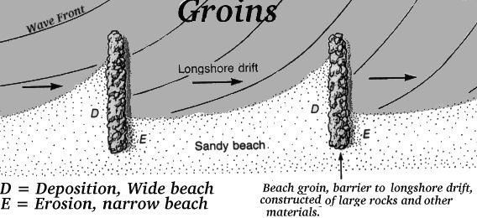
Groins
Groins are built perpendicular to the shoreline and are designed to trap sand and stop longshore drift (the movement of sand down the beach by the zig-zag motion)

Slide 20
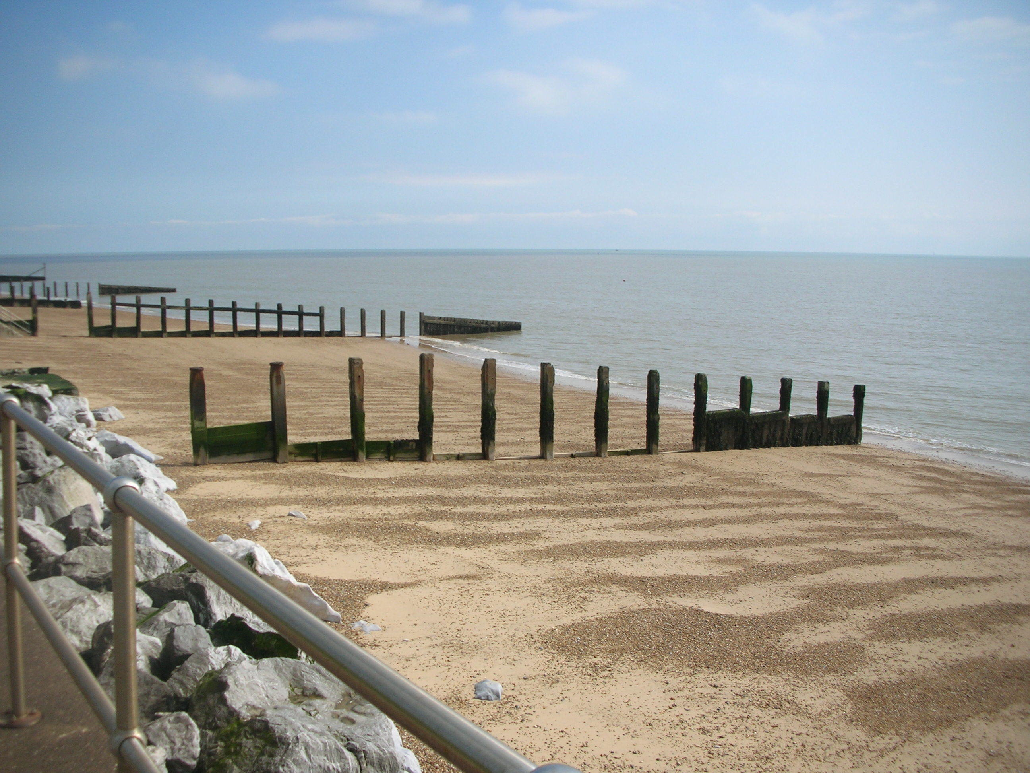

Slide 21
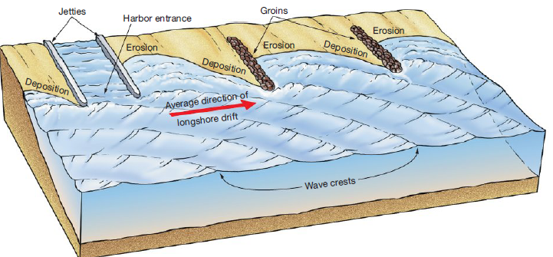
Jetties
A jetty is similar to a groin as it is designed to protect the shore from unwanted erosion.
They are built to protect the entrance to harbours.

Slide 22
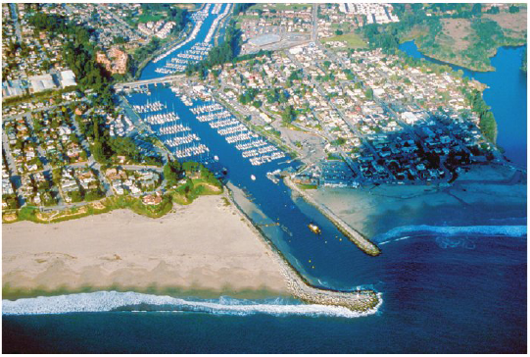

Slide 23
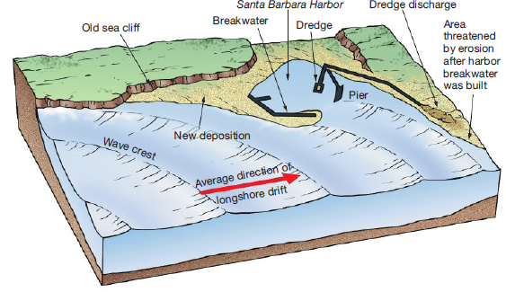
Breakwater
These will help disperse some of the energy of waves which will slow erosion and increase deposition along it
This protects areas which you may not want increased deposition (harbour entrance)

Slide 24
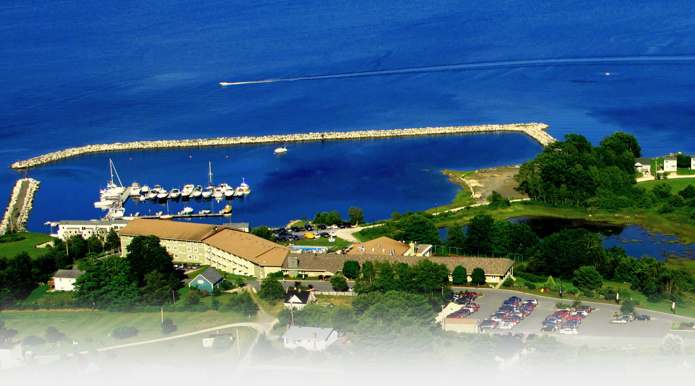
Oak Island Marina

Slide 25
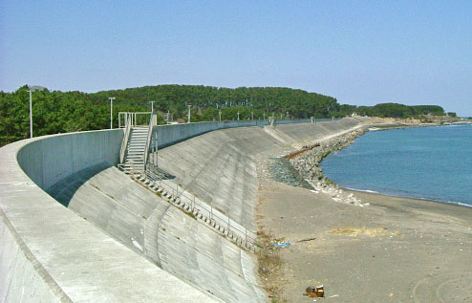
Sea Wall
Sea walls are built parallel to the shore and are designed to protect beach front properties from the relentless action of ocean waves

Slide 26
Alternatives to Hard Stabilizations
Hard stabilizations have many drawbacks so there are three major alternatives:
Beach replenishment – replace sand that is lost due to erosion
Construction Restrictions – do not allow construction in high risk areas.
Relocation – Relocate properties at risk

Slide 27
Pros and Cons – Hard Stabilizations
http://stateofthecoast.noaa.gov/shoreline/shoreline_armoring.html

