Slide 1
Climatic Factors Affecting Coastal Zone Structure and Properties

Slide 2
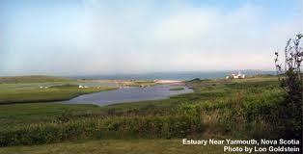
Rainfall Patterns
Determine the volume of freshwater input to a coastal zone
  (affects the presence and size of estuaries and marshes)

Slide 3
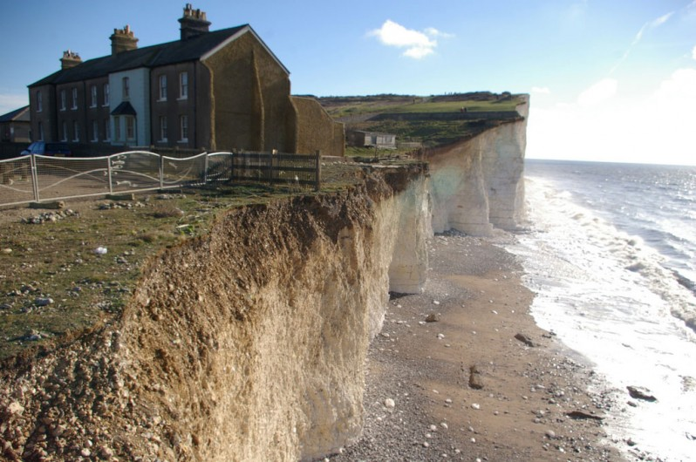
Wind Patterns
Affect the erosional forces from wind-induced waves that a coastline must endure

Slide 4
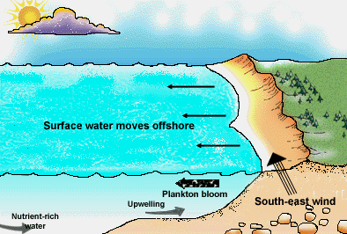
Wind Generated Ocean Current Patterns
Wind-generated ocean current patterns can combine with bathymetry to produce a coastal zone in which deep, nutrient-rich water is forced to the surface (upwelling), which creates a very productive ecosystem and a productive fishery.

Slide 5
Ocean Currents
Moderation of Coastal Climates

