Slide 1
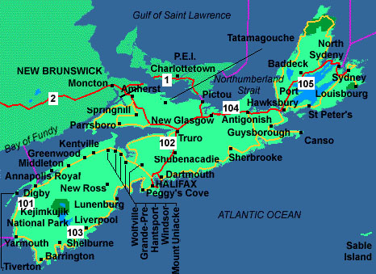
Halifax, Nova Scotia

Slide 2
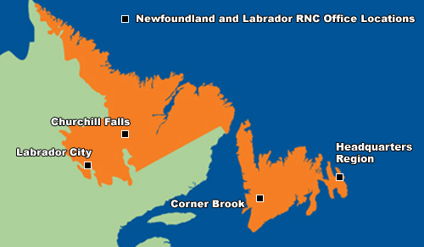
Churchill Falls, Labrador

Slide 3
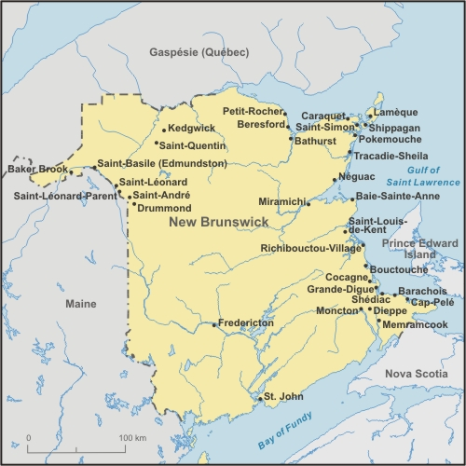
Kedgwick, New Brunswick

Slide 4
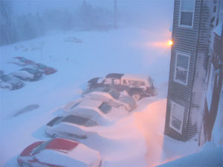
Five factors that influence our climate:
Latitude
Elevation
Ocean currents
Air Masses
Proximity to water
White Juan - 2004

Slide 5
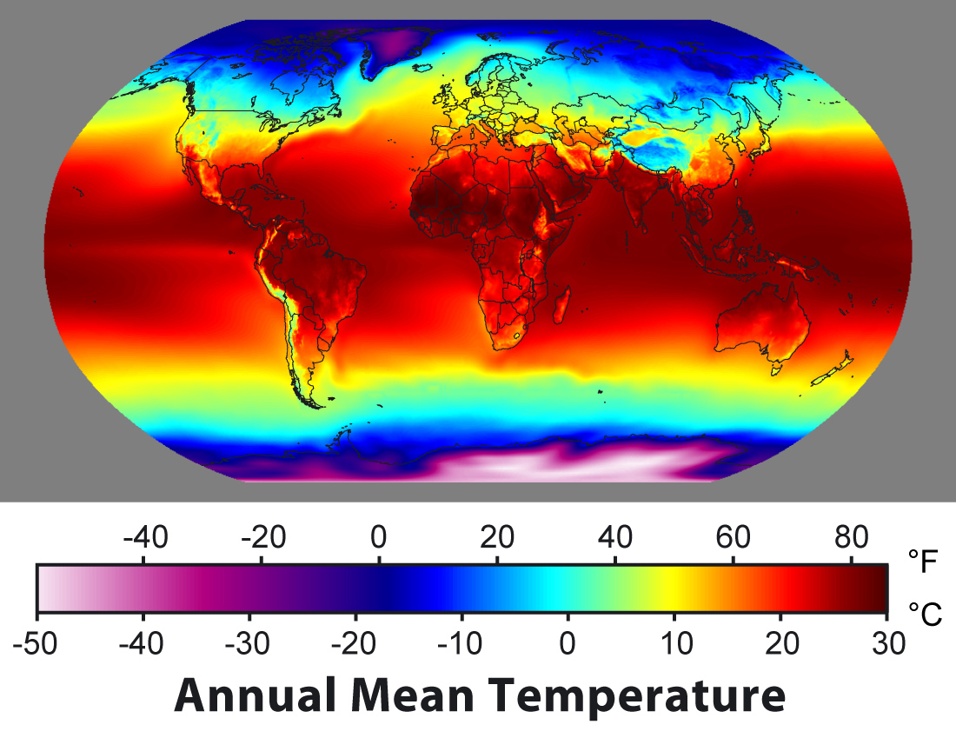
Latitude
In general, the FARTHER you are from the equator, the COLDER it becomes.
( latitude, temperature )
REASON:
Angle of incoming sun rays onto a sphere.
More concentrated at the equator (warmer)
More spread out at the poles (cooler)

Slide 6
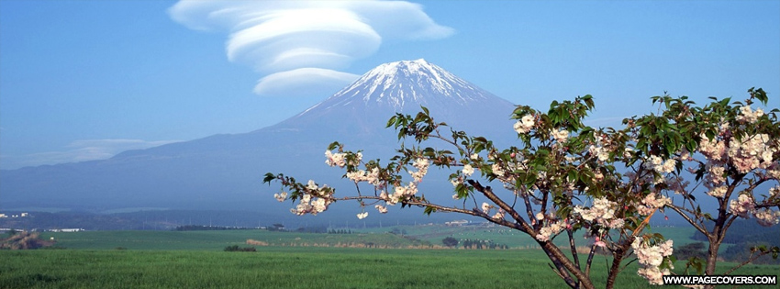
Elevation
elevation
temperature
REASON: air is thinner

Slide 7
Ocean Currents
A warm ocean current warms the land nearby.
A cold ocean current cools the land nearby.
The gulf stream helps fuel hurricanes and other storm systems with its warm water.
A collision of a warm and cold ocean current causes FOG.

Slide 8
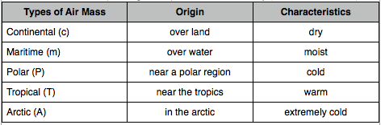
Air Masses
Take on the temperature and humidity characteristics of an area
Leading Edge = FRONT
STORMS – when warm moist air masses from the tropics meet the cold and dry air masses from the north.

Slide 9
Proximity to Water
The ocean moderates the climate of coastal regions because of its high specific heat capacity.
This is the reason why snow changes to rain along the coast for many storms that we receive during the winter.

