Slide 1
Climate Change
a change in a region’s climate.
Anthropogenic climate change – a change in a region’s climate that is primarily caused by human activity
Reason: emission of greenhouse gases (carbon dioxide, methane, nitrous oxide,…)
  Fossil fuel burning (factories)
  Car emissions
  Deforestation
Notes:
Just scratching the surface. (I took a whole class on this topic in university)
Water vapour is also a greenhouse gas.
Coal, oil and gas are called "fossil fuels" because they have been formed from the organic remains of prehistoric plants and animals. (by exposure to heat and pressure in the earth’s crust over hundreds of millions of years)

Slide 2
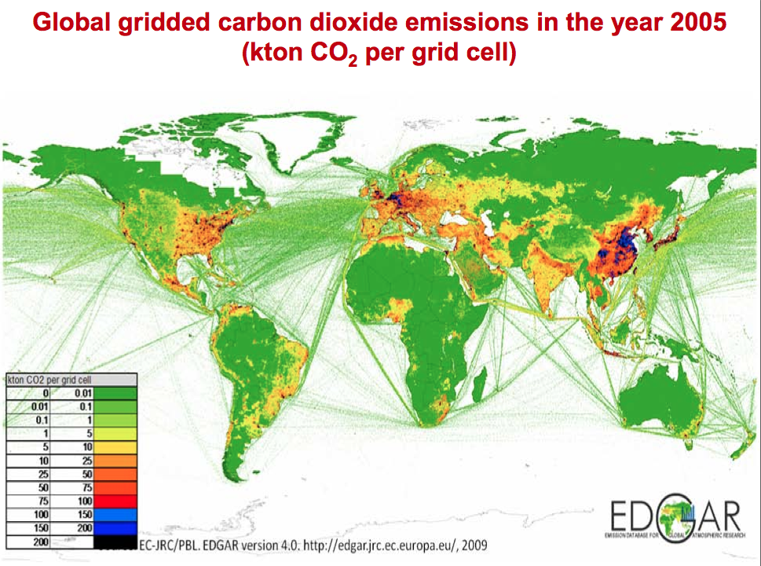

Slide 3
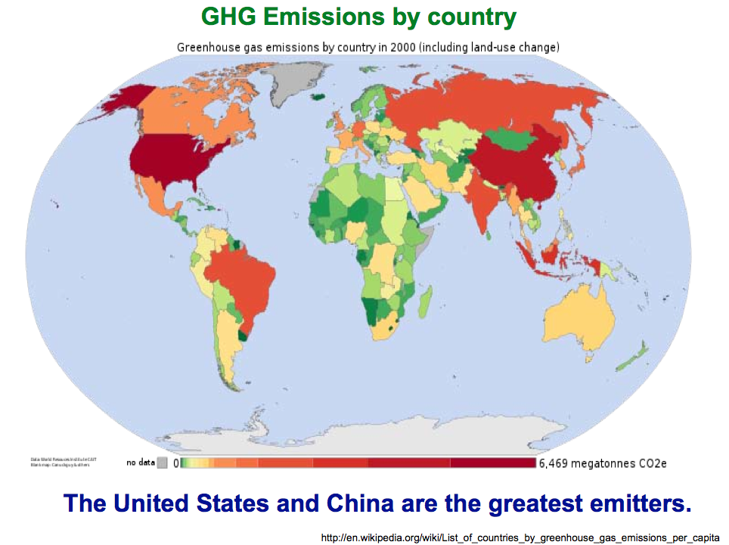

Slide 4
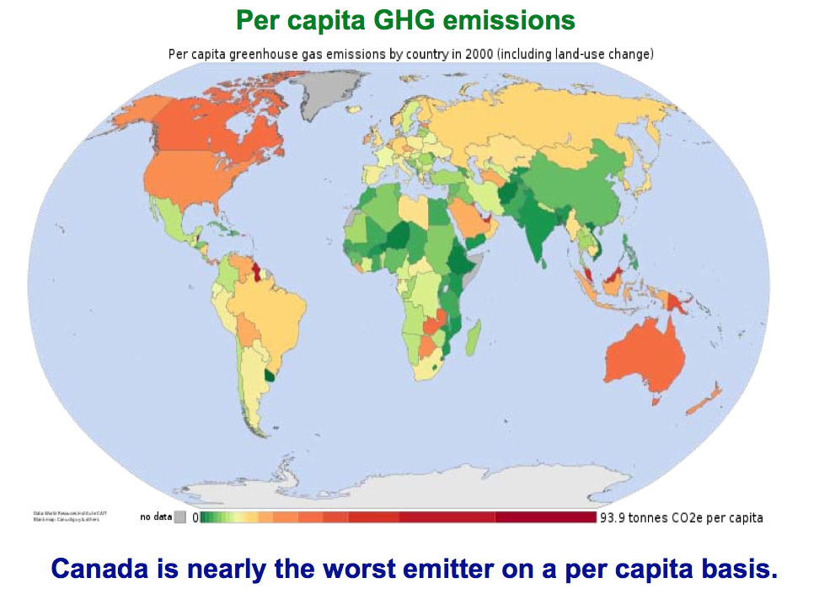

Slide 5
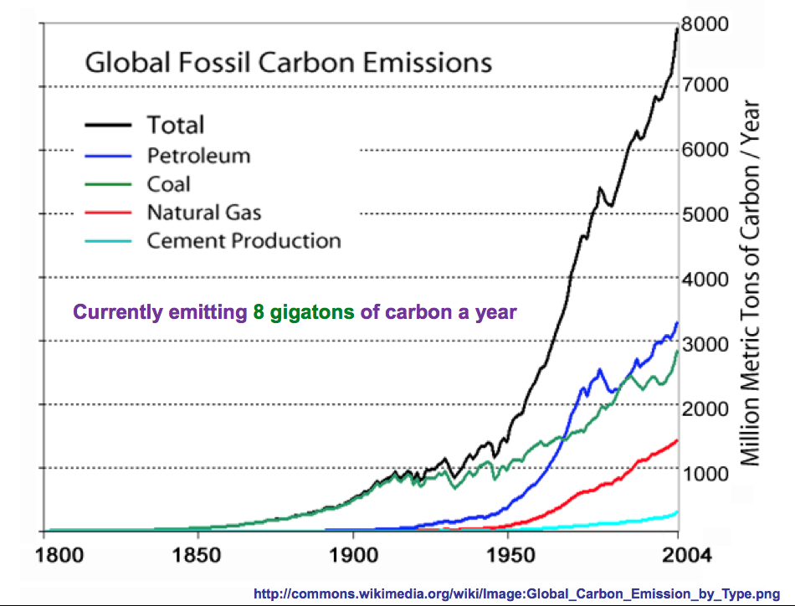

Slide 6
Greenhouse effect: the trapping of heat in our atmosphere by greenhouse gases. These greenhouse gases absorb the heat that is reflected off of the earth’s surface.
Greenhouse gas: any gas that absorbs infrared radiation in the atmosphere
Notes:
Short Wave Radiation (solar) vs Long Wave Radiation (infrared)
Natural Greenhouse effect (warms earth from -18 to +15 average temperature)

Slide 7
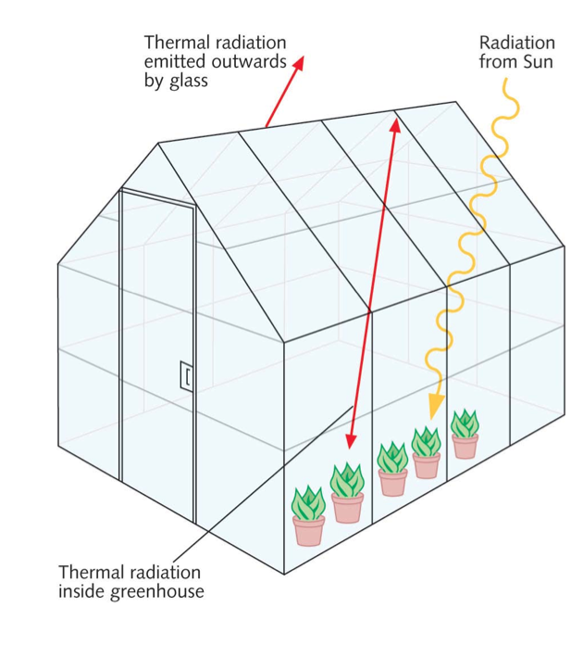

Slide 8
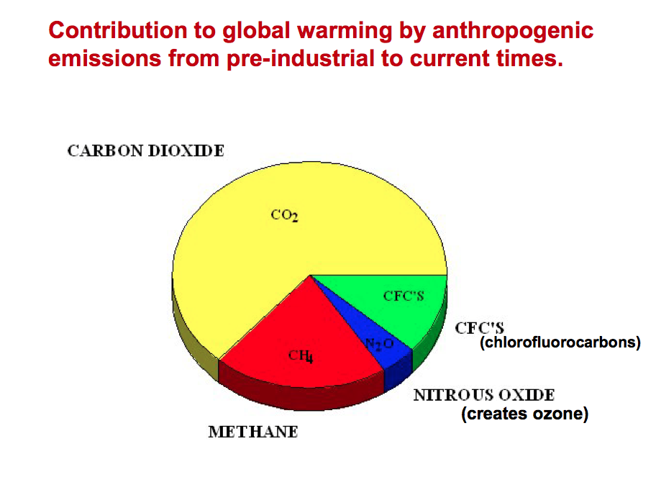

Slide 10
Climate Change Indicators…

Slide 11
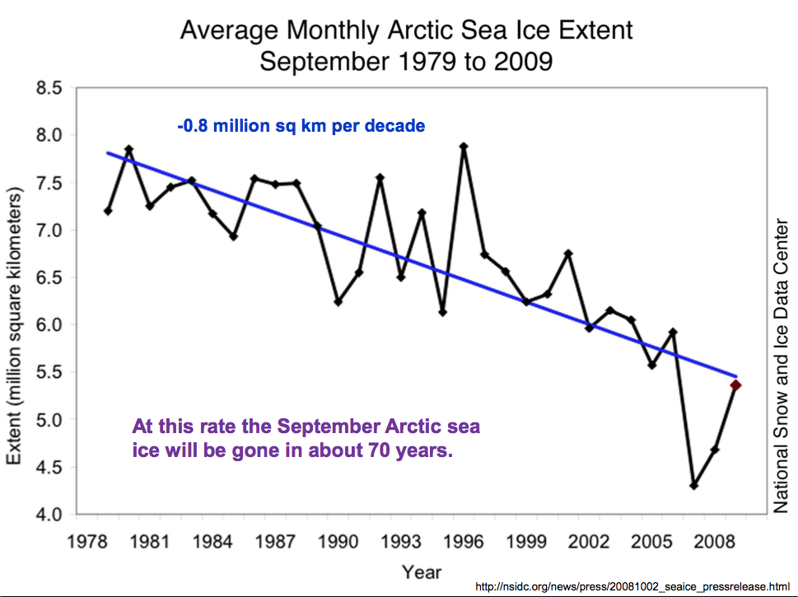

Slide 12
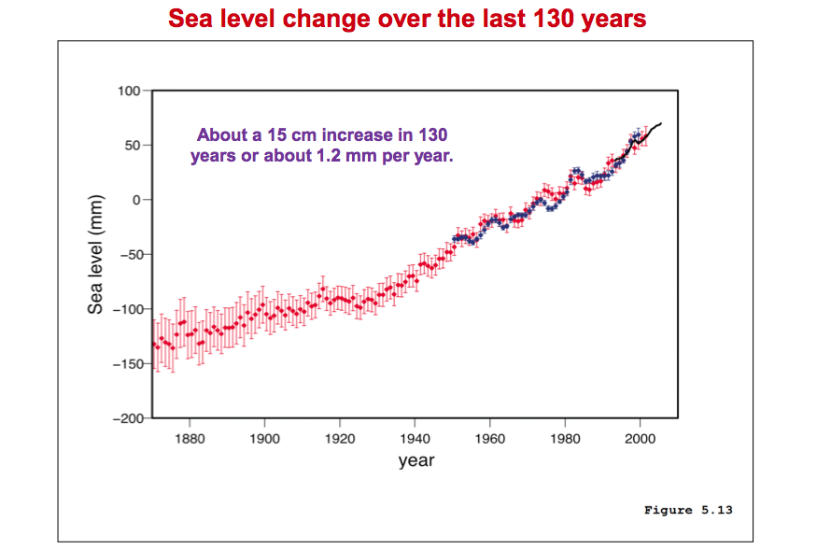

Slide 13
Alternative Energy Sources…

Slide 14
Renewable Energy Sources
Energy resources that are naturally replenishing such as biomass, hydro, geothermal, solar, wind, ocean thermal, wave action, and tidal action.
Definition from:
( http://www.epa.gov/climatechange/glossary.html)
Notes:
Finite amount of fossil fuels.
These renewable energy sources are much cleaner than fossil fuels.
Still problems associated with them: noise from wind turbines, tidal power hurts marine and fish populations. Your job next class to figure out which one is best!

Slide 15
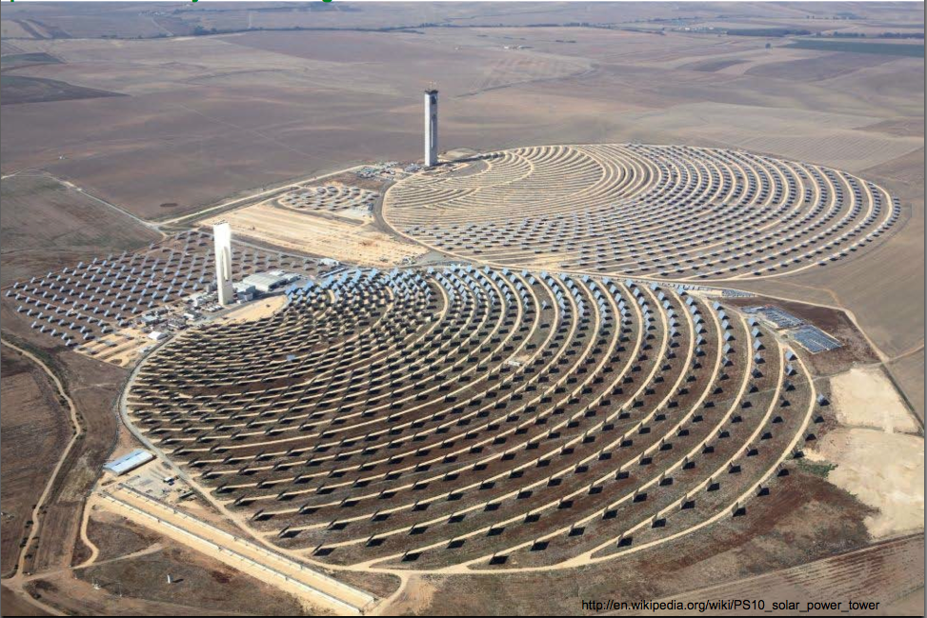
Solar power in Seville, Spain…
Notes:
11 Mwatts of power from 624 large movable mirrors

Slide 16
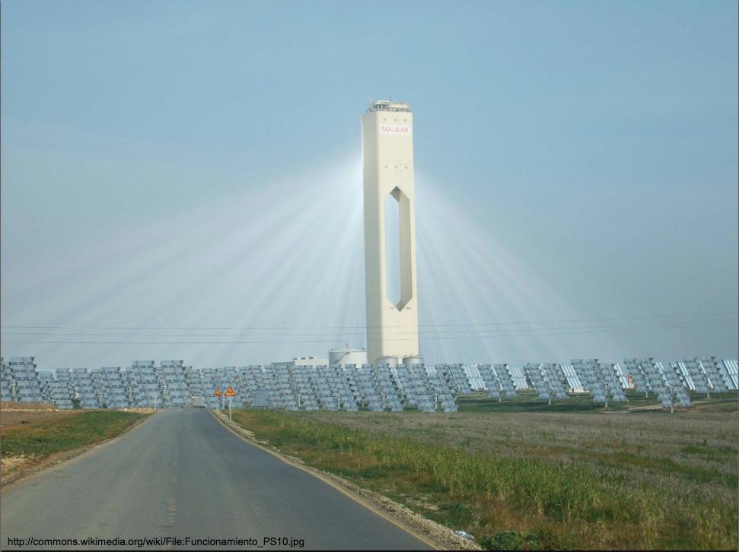

Slide 17
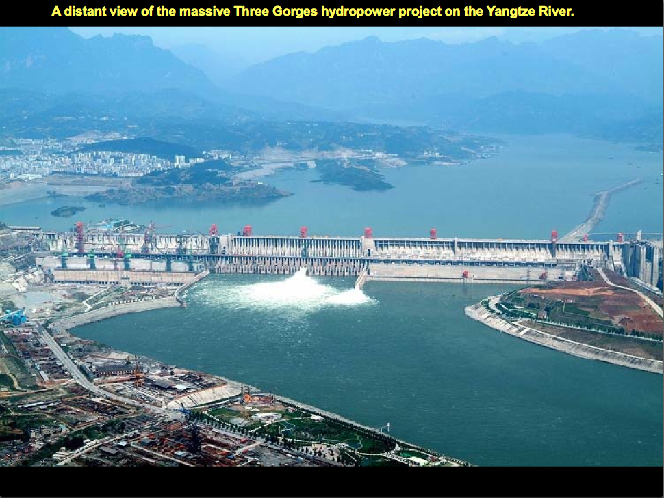
Notes:
Third-largest river in the world (china)

Slide 18
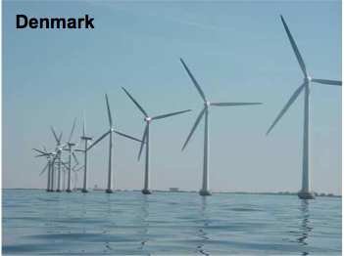
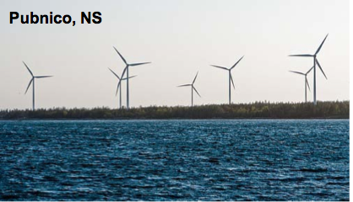
Wind Power

Slide 19
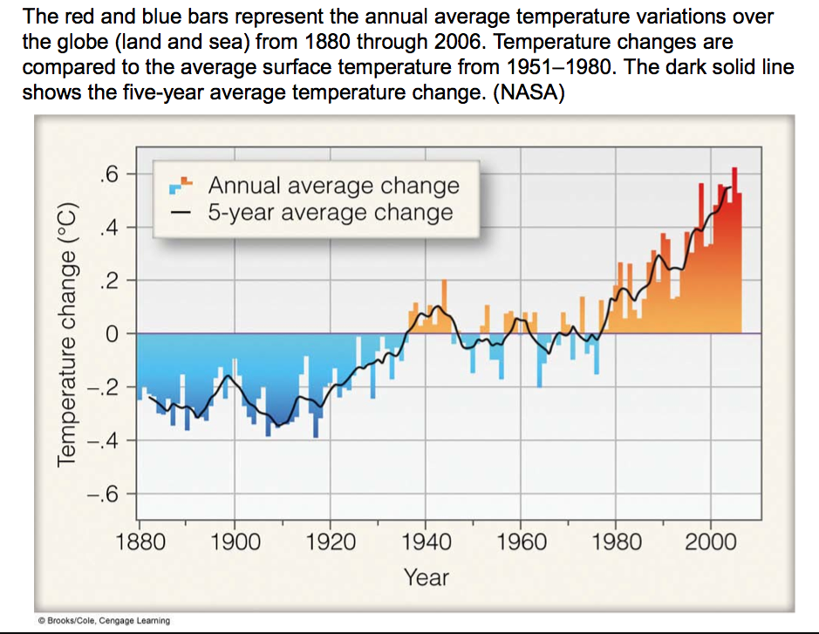

Slide 20
Videos…

